Slide 1
A New Approach to Air Force Career Field Assignment
D. Griffen Laird, Air Force Personnel Center
17 Nov 2022

Slide 2
Overview
Background
Problem Description
VFT Model
Solution Methods
Model Comparison
Conclusions

Slide 3
Background
“What distinguishes our military, what makes us the premier fighting force in the world and guarantees it will prevail in any conflict, is the quality of our service members” Secretary of Defense Mark T. Esper

Slide 4

Background
Each year, the Air Force Personnel Center (AFPC) assigns cadets to their career fields, denoted by Air Force Specialty Codes (AFSCs)
AFSCs secure the future lieutenants’ careers in the Air Force
Feasible solutions must meet certain objective criteria

Slide 5

Problem Description
Air Force defines “priorities” for the assignment solution
Priorities pertain to characteristics of the cadets assigned to the AFSCs

Slide 6
Problem Description
AFSC Quotas
Range on number of cadets to be assigned
Most important priority
AFSC Qualifications
Based on degrees listed in Air Force Officer Classification Directory (AFOCD)
Three tier requirement levels: “Mandatory”, “Desired”, “Permitted”
Balancing Objectives
Order of merit (quality of cadets)
Source of commissioning (proportion of USAFA cadets)
Cadet Preference
Utility values placed on each AFSC measure cadet satisfaction
Ties and incomplete preference lists allowed

Slide 7
VFT Model
“Value-Focused Thinking” (VFT) Objective Hierarchy
Cadets have one objective: Maximize Utility
AFSCs may have up to nine objectives
Balance Merit
Balance USAFA Proportion
Meet Combined Quota
Meet USAFA Quota
Meet ROTC Quota
Meet Mandatory AFOCD degree tier target
Meet Desired AFOCD degree tier target
Meet Permitted AFOCD degree tier target
Maximize Utility of assigned cadets
Objective independence can be assumed

Slide 8
VFT Model
“Value-Focused Thinking” (VFT) Objective Hierarchy
Maximize Solution Quality

Slide 9
VFT Model
“Value-Focused Thinking” (VFT) Objective Hierarchy
Maximize Solution Quality
Maximize Cadet Solution Value

Slide 10
VFT Model
“Value-Focused Thinking” (VFT) Objective Hierarchy
Maximize Solution Quality
Maximize Cadet Solution Value
Maximize AFSC Solution Value

Slide 11
VFT Model
“Value-Focused Thinking” (VFT) Objective Hierarchy
Maximize Solution Quality
Maximize Cadet Solution Value
Maximize AFSC Solution Value
Maximize Cadet 1 Utility
Maximize Cadet N Utility
…

Slide 12
VFT Model
“Value-Focused Thinking” (VFT) Objective Hierarchy
Maximize Solution Quality
Maximize Cadet Solution Value
Maximize AFSC Solution Value
Maximize Cadet 1 Utility
Maximize Cadet N Utility
Maximize AFSC 1 Value
Maximize AFSC M Value
…
…

Slide 13
VFT Model
“Value-Focused Thinking” (VFT) Objective Hierarchy
Maximize Solution Quality
Maximize Cadet Solution Value
Maximize AFSC Solution Value
Maximize Cadet 1 Utility
Maximize Cadet N Utility
Maximize AFSC 1 Value
Maximize AFSC M Value
…
…
Maximize AFSC 1 Objective 1 Value
Maximize AFSC 1 Objective O Value
Maximize AFSC M Objective 1 Value
Maximize AFSC M Objective O Value
…
…

Slide 14
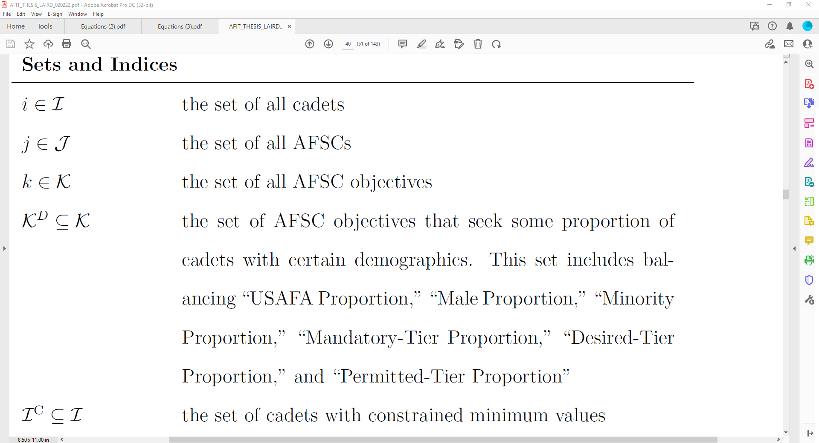
VFT Model
Optimization Model
Sets and Indices
Three main sets of entities
Additional subsets for cadet/AFSC characteristics

Slide 15
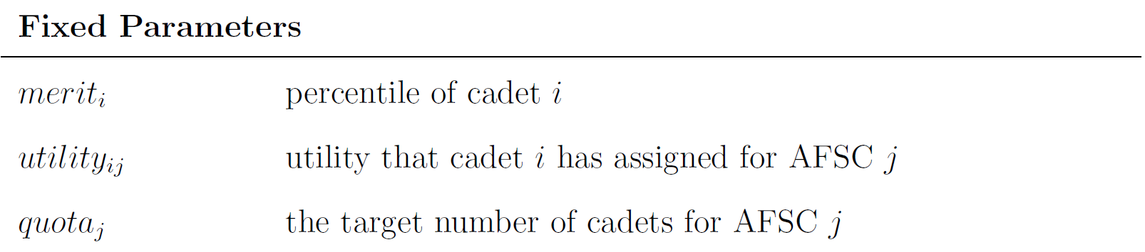
VFT Model
Optimization Model
Parameters
“Fixed” parameters cannot be altered

Slide 16
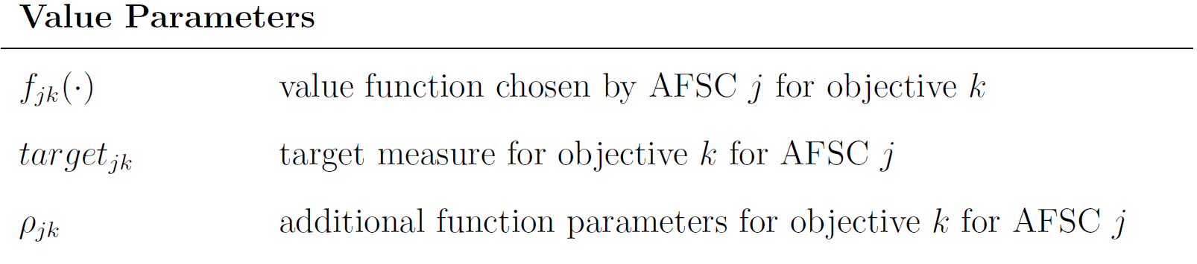
VFT Model
Optimization Model
Parameters
“Fixed” parameters cannot be altered
“Value” parameters define value functions

Slide 17
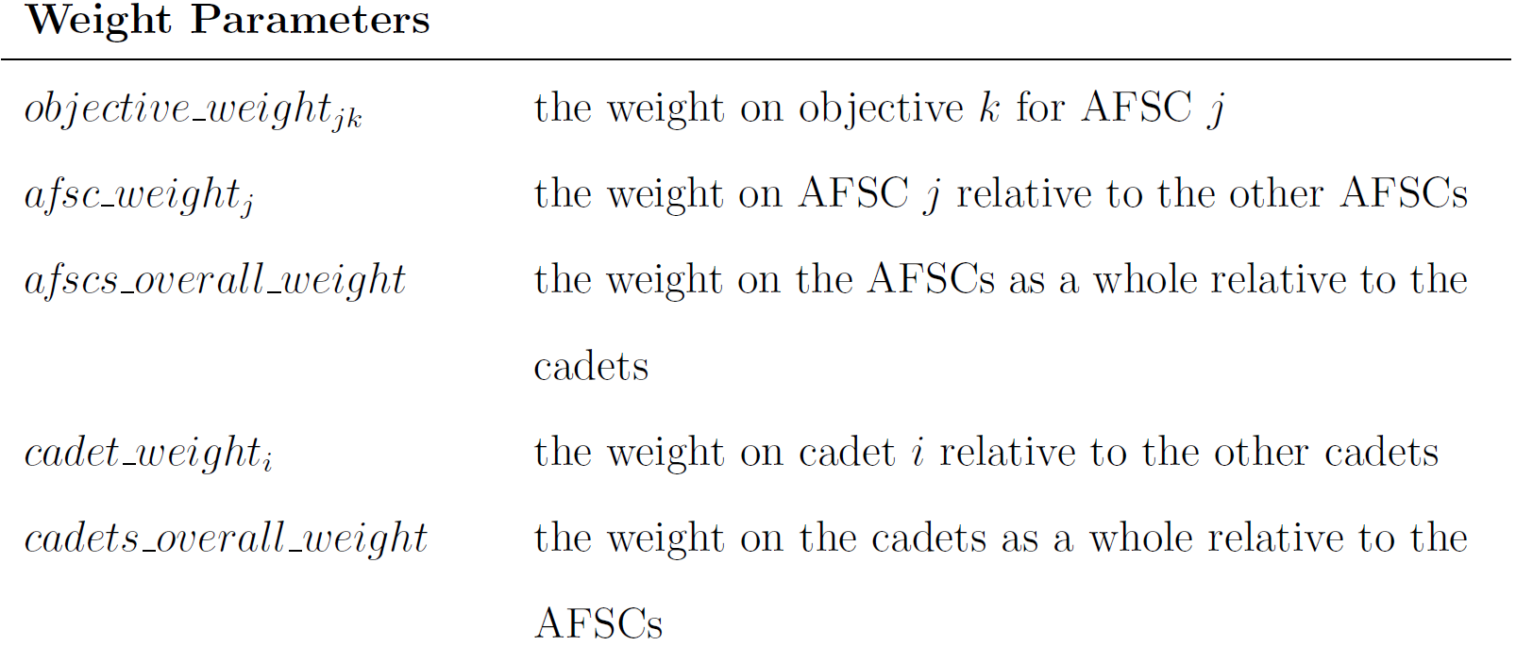
VFT Model
Optimization Model
Parameters
“Fixed” parameters cannot be altered
“Value” parameters define value functions
“Weight” parameters prescribe importance to the objectives

Slide 18
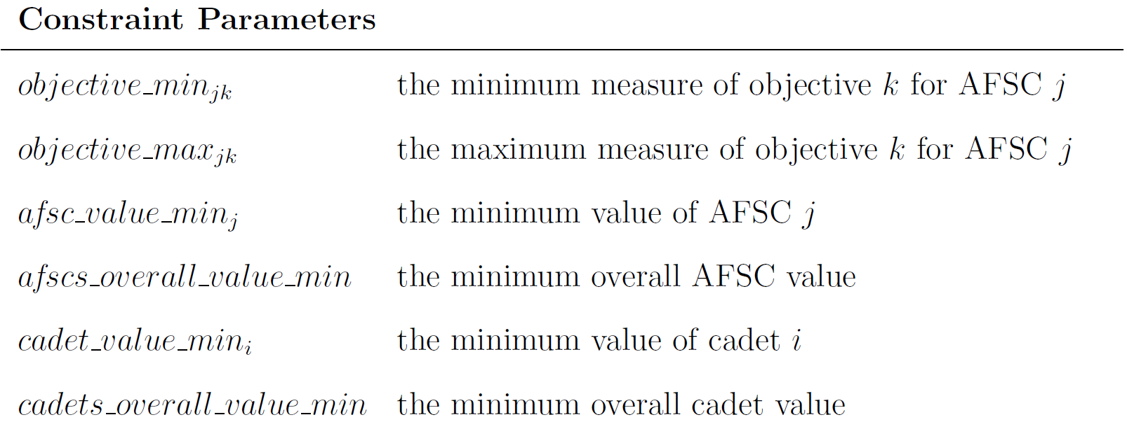
VFT Model
Optimization Model
Parameters
“Fixed” parameters cannot be altered
“Value” parameters define value functions
“Weight” parameters prescribe importance to the objectives
“Constraint” parameters do not alter value hierarchy

Slide 19
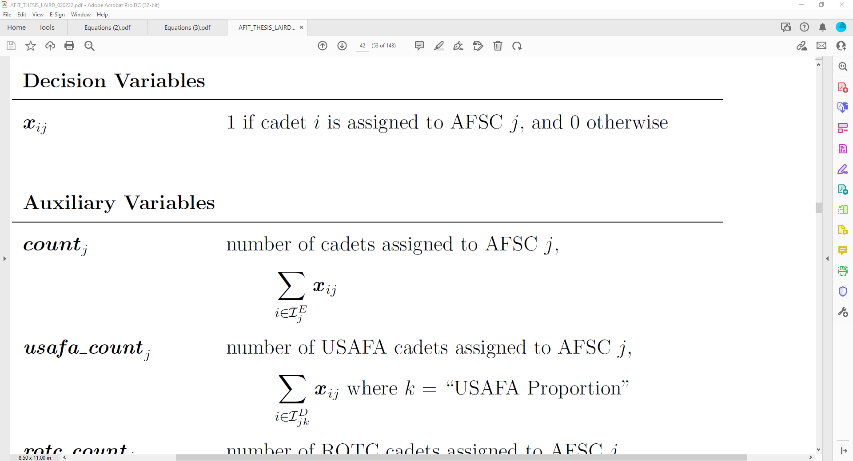
VFT Model
Optimization Model
Variables
Same decision variable

Slide 20
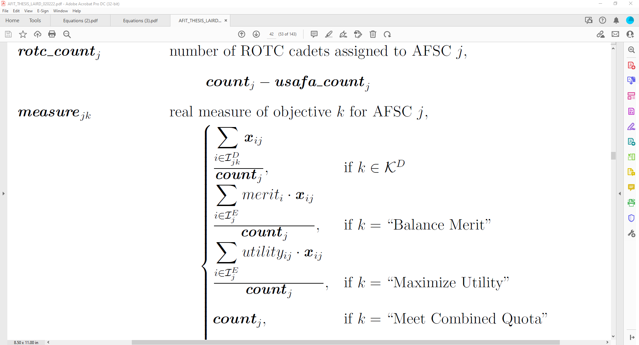
VFT Model
Optimization Model
Variables
Same decision variable
Auxiliary variables defined for simplicity

Slide 21
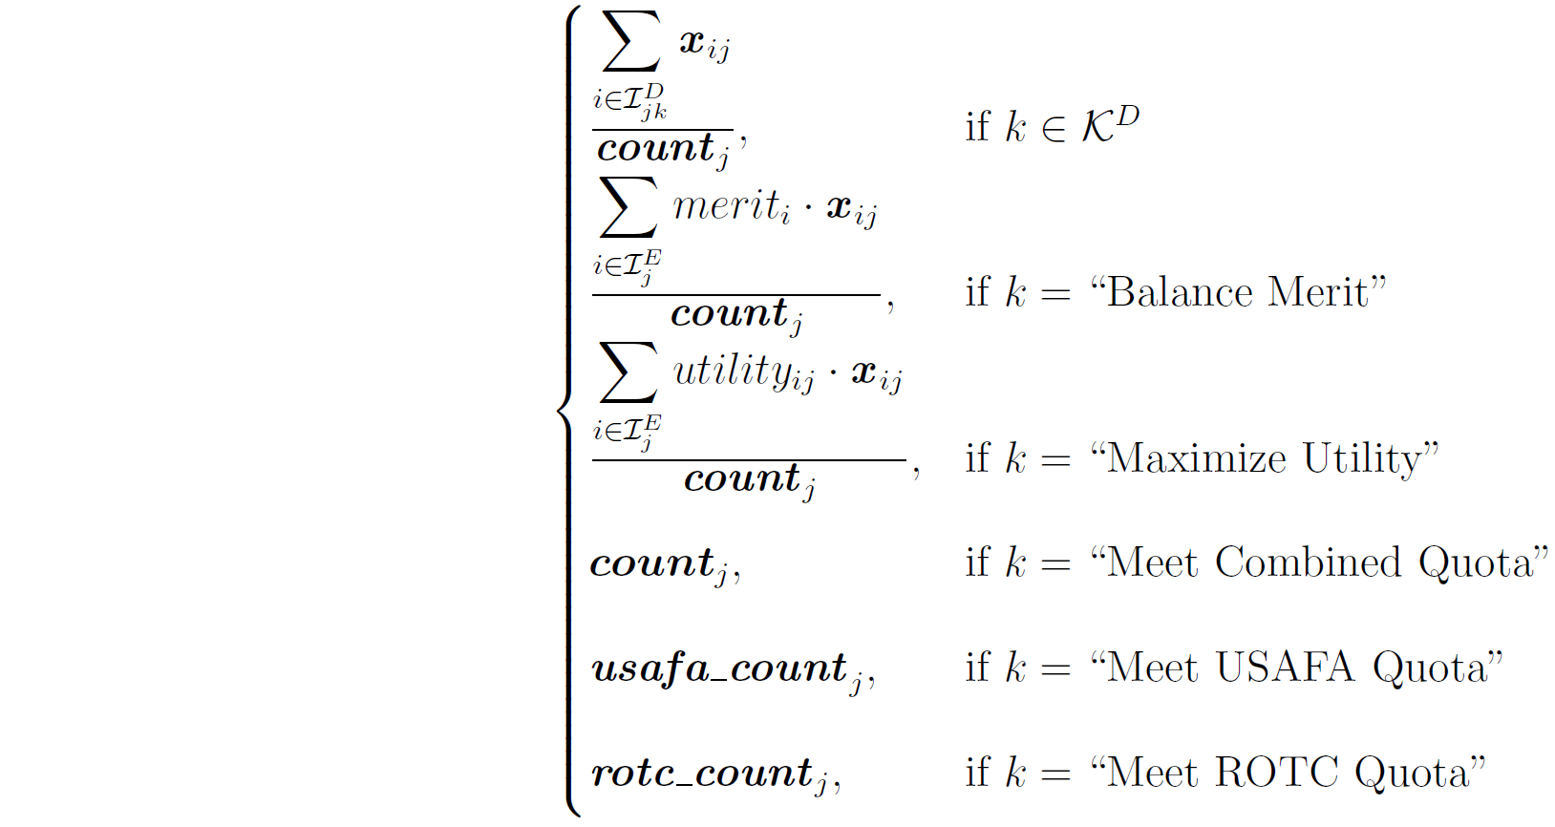
VFT Model
Optimization Model
Variables
Same decision variable
Auxiliary variables defined for simplicity

Slide 22
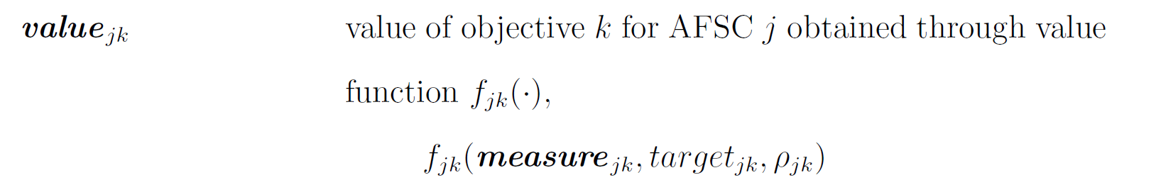
VFT Model
Optimization Model
Variables
Same decision variable
Auxiliary variables defined for simplicity
Relationship to Objective Hierarchy
Maximize AFSC 1 Objective 1 Value

Slide 23
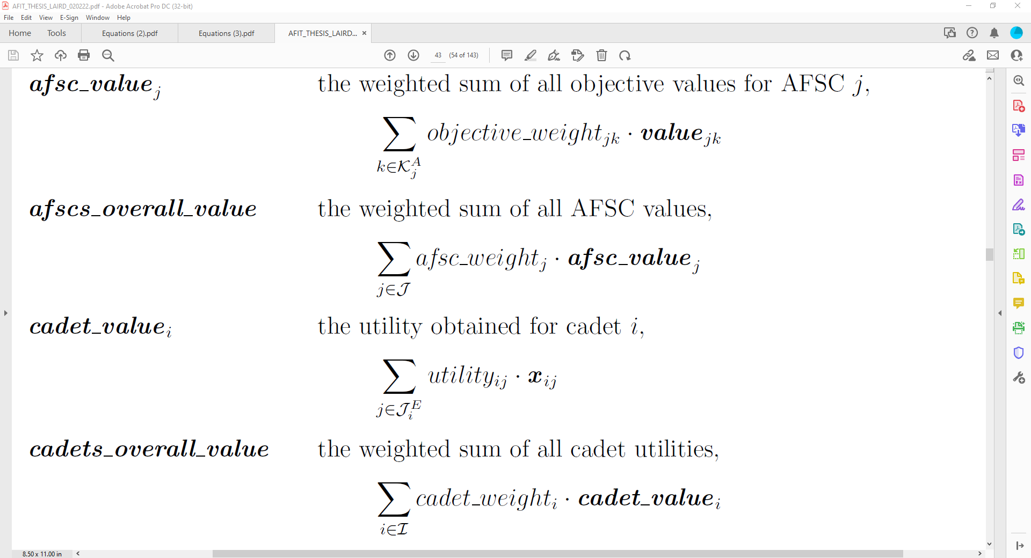
VFT Model
Optimization Model
Variables
Same decision variable
Auxiliary variables defined for simplicity
Relationship to Objective Hierarchy
Maximize AFSC 1 Value
Maximize AFSC 1 Objective 1 Value
Maximize AFSC 1 Objective O Value
…

Slide 24
VFT Model
Optimization Model
Variables
Same decision variable
Auxiliary variables defined for simplicity
Relationship to Objective Hierarchy
Maximize AFSC Solution Value
Maximize AFSC 1 Value
…
Maximize AFSC M Value
Maximize AFSC 1 Objective 1 Value
Maximize AFSC 1 Objective O Value
Maximize AFSC M Objective 1 Value
Maximize AFSC M Objective O Value
…
…

Slide 25
VFT Model
Optimization Model
Variables
Same decision variable
Auxiliary variables defined for simplicity
Relationship to Objective Hierarchy
Maximize AFSC Solution Value
Maximize Cadet 1 Utility
Maximize AFSC 1 Value
…
Maximize AFSC M Value
Maximize AFSC 1 Objective 1 Value
Maximize AFSC 1 Objective O Value
Maximize AFSC M Objective 1 Value
Maximize AFSC M Objective O Value
…
…

Slide 26
VFT Model
Optimization Model
Variables
Same decision variable
Auxiliary variables defined for simplicity
Relationship to Objective Hierarchy
Maximize Cadet Solution Value
Maximize AFSC Solution Value
Maximize Cadet 1 Utility
…
Maximize Cadet N Utility
Maximize AFSC 1 Value
…
Maximize AFSC M Value
Maximize AFSC 1 Objective 1 Value
Maximize AFSC 1 Objective O Value
Maximize AFSC M Objective 1 Value
Maximize AFSC M Objective O Value
…
…

Slide 27
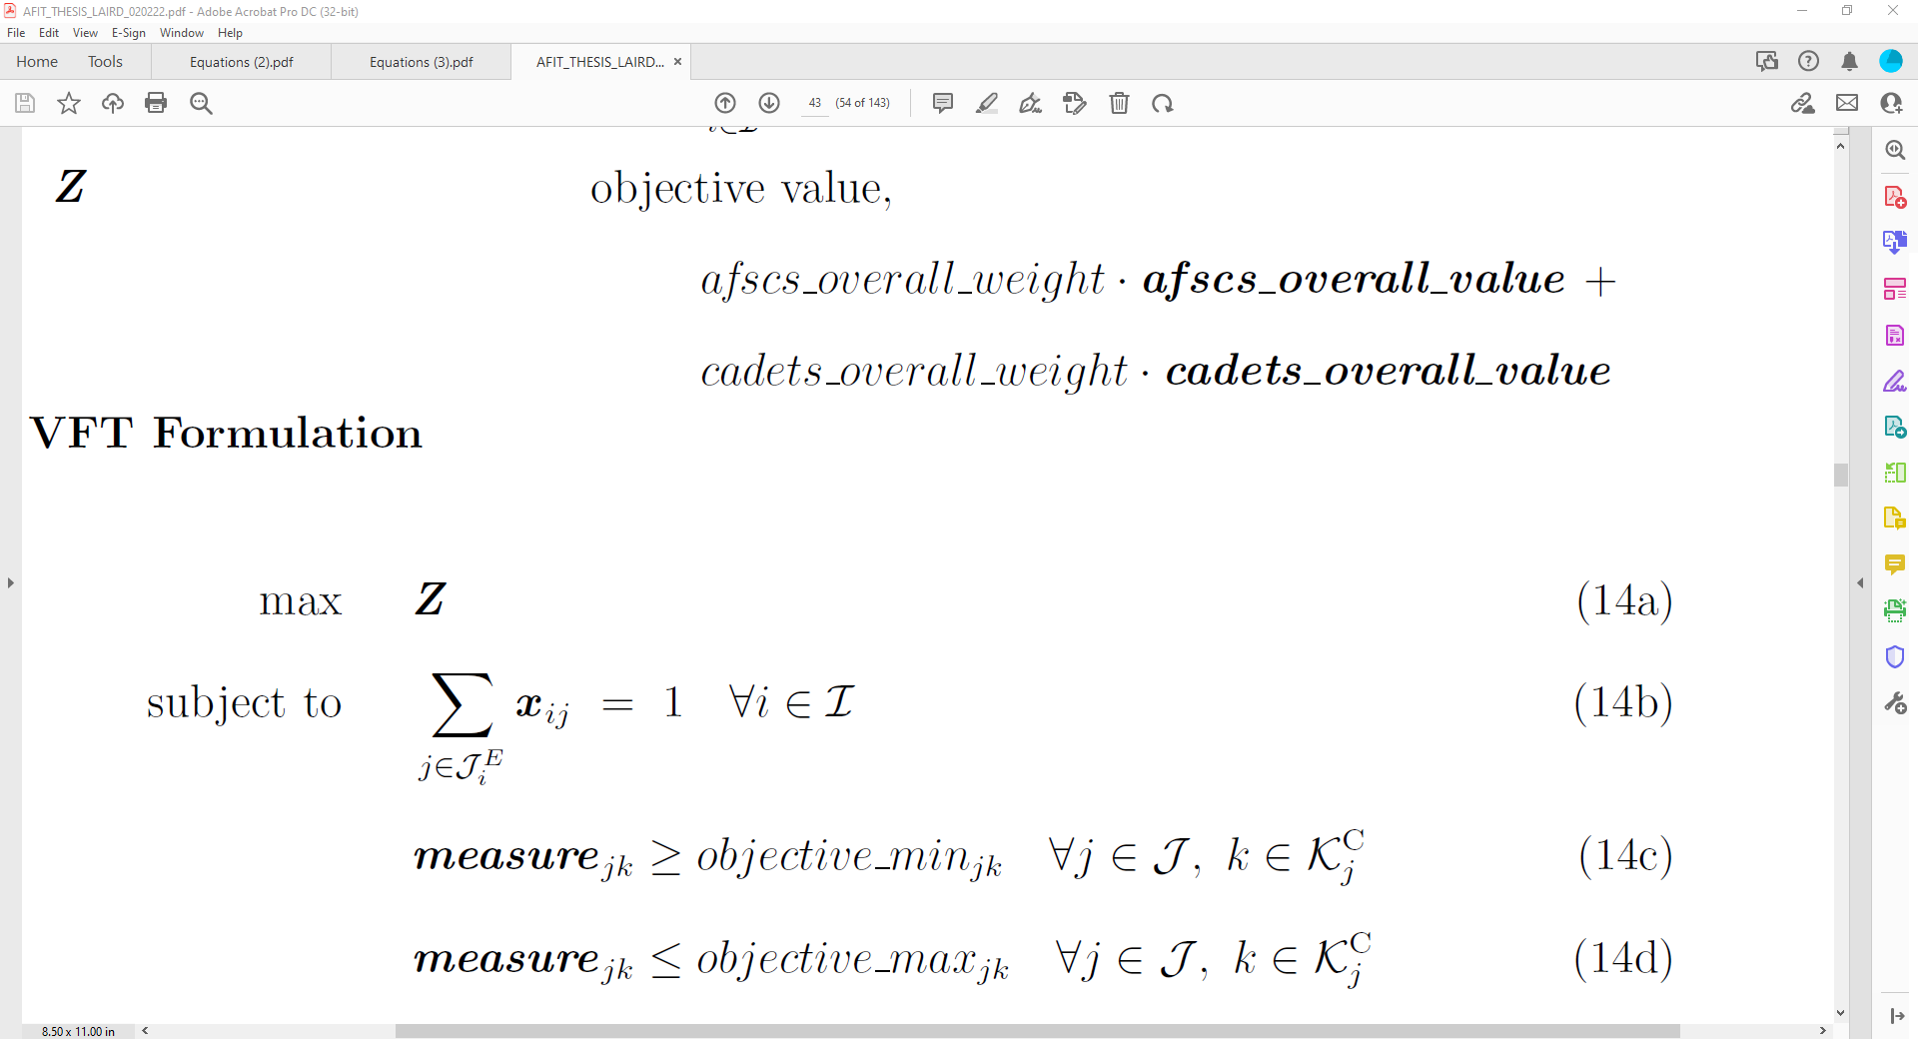
VFT Model
Optimization Model
Variables
Same decision variable
Auxiliary variables defined for simplicity
Relationship to Objective Hierarchy
Maximize Solution Quality
Maximize Cadet Solution Value
Maximize AFSC Solution Value
Maximize Cadet 1 Utility
…
Maximize Cadet N Utility
Maximize AFSC 1 Value
…
Maximize AFSC M Value
Maximize AFSC 1 Objective 1 Value
Maximize AFSC 1 Objective O Value
Maximize AFSC M Objective 1 Value
Maximize AFSC M Objective O Value
…
…

Slide 28
VFT Model
Optimization Model
Formulation
Objective: Maximize Solution Quality
Maximize Solution Quality
Maximize Cadet Solution Value
Maximize AFSC Solution Value
Maximize Cadet 1 Utility
…
Maximize Cadet N Utility
Maximize AFSC 1 Value
…
Maximize AFSC M Value
Maximize AFSC 1 Objective 1 Value
Maximize AFSC 1 Objective O Value
Maximize AFSC M Objective 1 Value
Maximize AFSC M Objective O Value
…
…

Slide 29
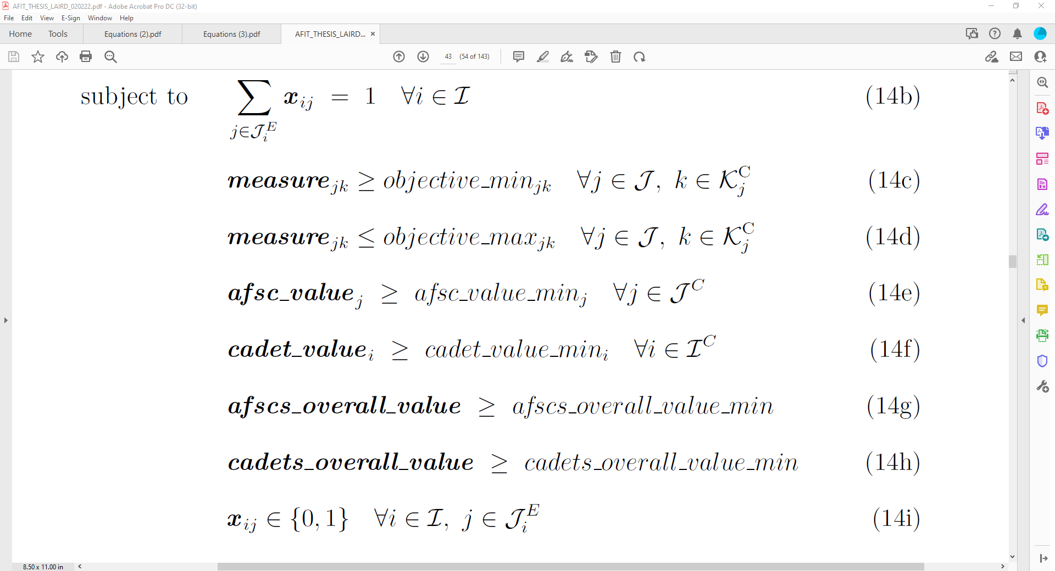
VFT Model
Optimization Model
Formulation
Objective: Maximize Solution Quality
Some “basic” constraints
Maximize Solution Quality
Maximize Cadet Solution Value
Maximize AFSC Solution Value
Maximize Cadet 1 Utility
…
Maximize Cadet N Utility
Maximize AFSC 1 Value
…
Maximize AFSC M Value
Maximize AFSC 1 Objective 1 Value
Maximize AFSC 1 Objective O Value
Maximize AFSC M Objective 1 Value
Maximize AFSC M Objective O Value
…
…

Slide 30
VFT Model
Optimization Model
Formulation
Objective: Maximize Solution Quality
Some “basic” constraints
Value constraints can be added if needed
Maximize Solution Quality
Maximize Cadet Solution Value
Maximize AFSC Solution Value
Maximize Cadet 1 Utility
…
Maximize Cadet N Utility
Maximize AFSC 1 Value
…
Maximize AFSC M Value
Maximize AFSC 1 Objective 1 Value
Maximize AFSC 1 Objective O Value
Maximize AFSC M Objective 1 Value
Maximize AFSC M Objective O Value
…
…

Slide 31
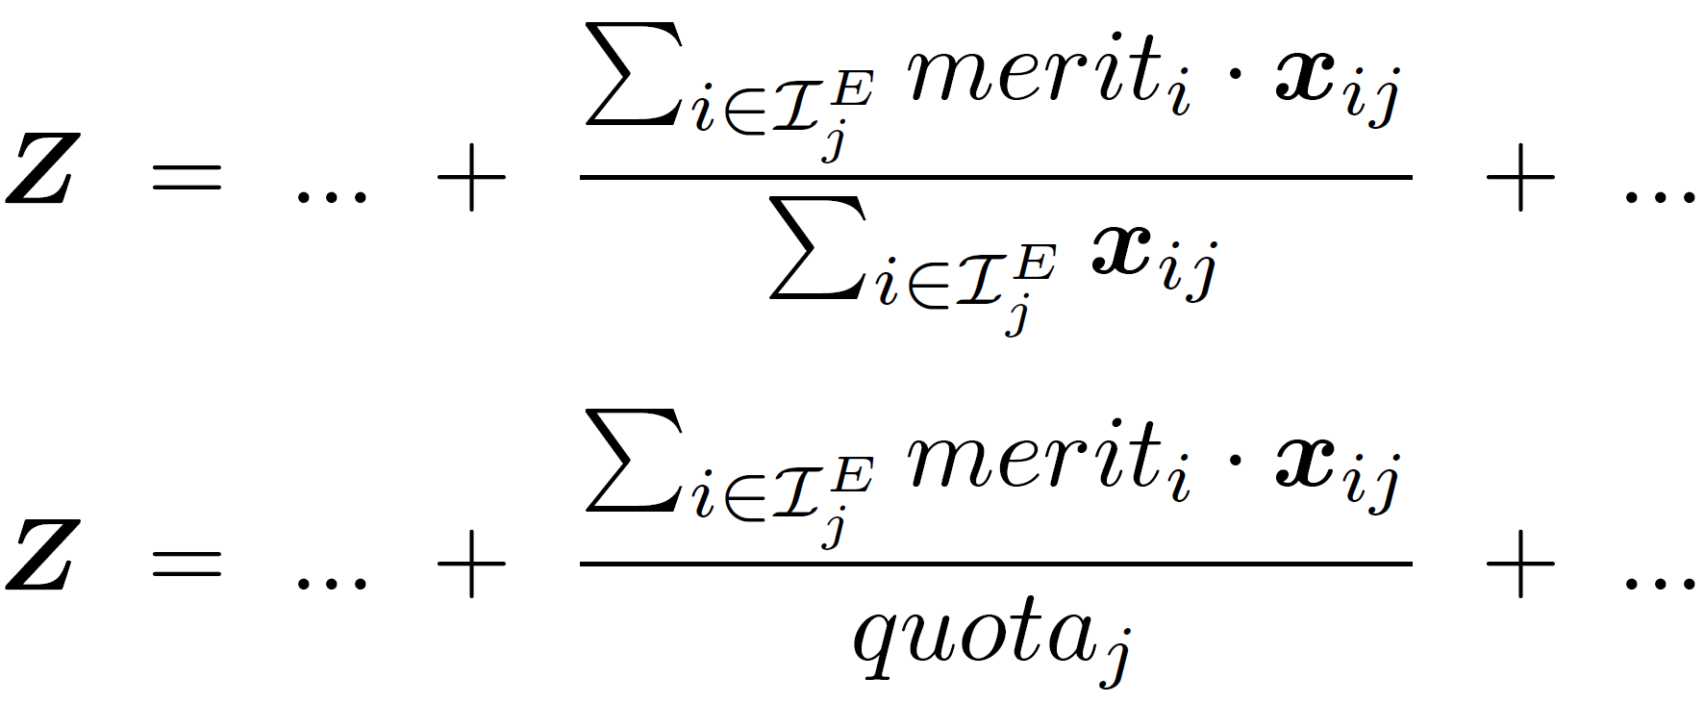
Solution Methods
Model Complexity
Non-linear term in objective function
Cannot be factored out
Approximated with AFSC quota
Two Models: “Approximate” and “Exact”
Notes:
Objective function is non-convex!

Slide 32
Solution Methods
Model Complexity
Non-linear term in objective function
Cannot be factored out
Approximated with AFSC quota
Two Models: “Approximate” and “Exact”
Notes:
Cannot factor out the variable in the denominator

Slide 33
Solution Methods
Model Complexity
Non-linear term in objective function
Cannot be factored out
Approximated with AFSC quota
Two Models: “Approximate” and “Exact”
Notes:
I know I criticized this before…

Slide 34
Solution Methods
Model Complexity
Non-linear term in objective function
Cannot be factored out
Approximated with AFSC quota
Two Models: “Approximate” and “Exact”
Used in Approximate Model
Used in Exact Model
Notes:
The only objective function we care about is the exact model objective function!

Slide 35
Solution Methods
Solution Techniques
Conditional Tabular Generative Adversarial Network (CTGAN) applied to generate sets of cadets [11]
Historic averages used for AFSC quotas
15 datasets generated using CTGAN
Each dataset converted to 4 unique problem instances by generating different value hierarchies (sets of weight and value parameters)
Notes:
Now that we have our solvers, I need to develop my main solution methodology…
I want to generate realistic cadet data…
More information on what I did with CTGAN is in the backups

Slide 36
Solution Methods
Solution Techniques
Solvers
“Coin-OR Branch and Cut” (CBC) for Approximate Model
“Interior Point Optimizer” (IPOPT) for Exact Model
Approximate model and Exact model each provide their initial solutions to Genetic Algorithm (GA)
GA runs for 10 minutes
Solutions compared to baseline random solution

Slide 37
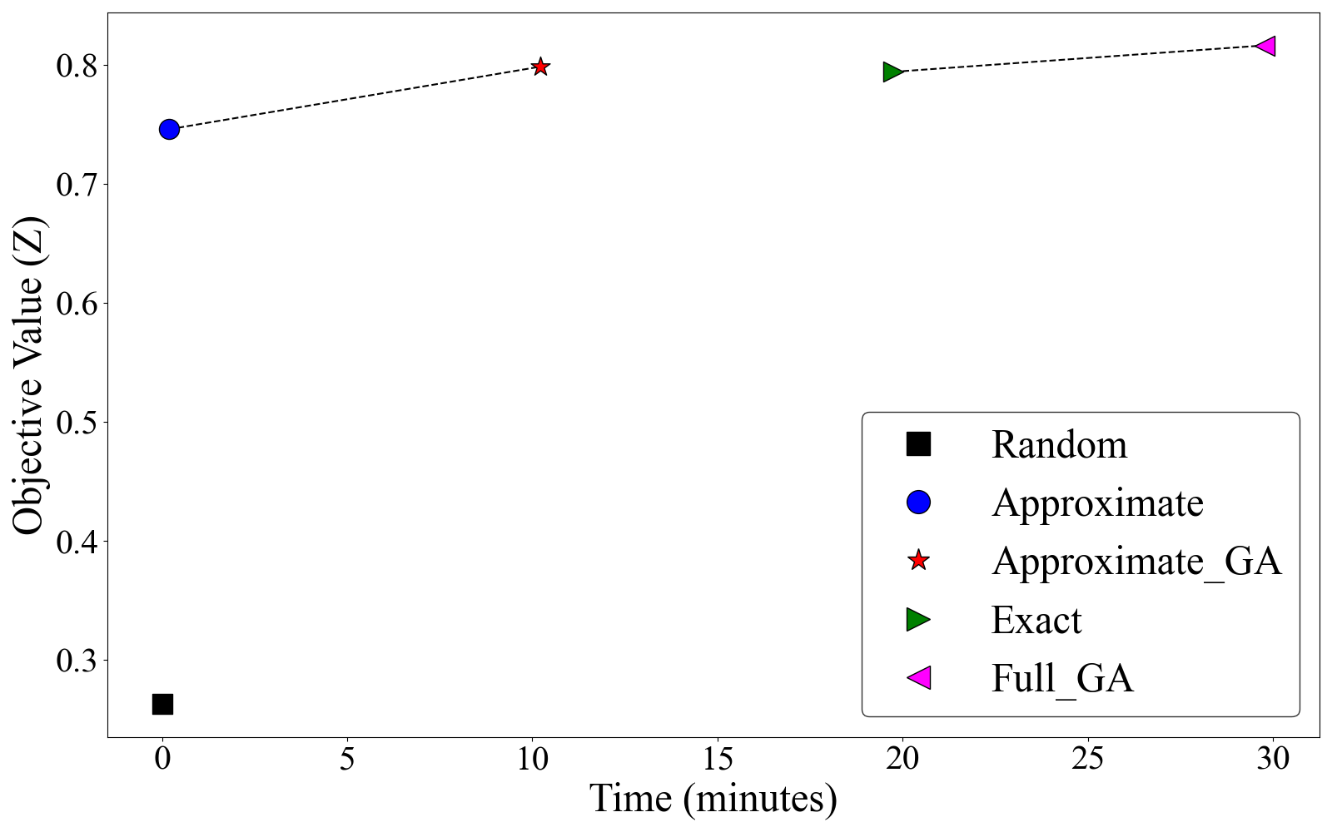
Solution Methods
Solution Techniques
Averaged results across all 60 problem instances compared to averaged random solution value
GA w/Approximate
Exact
GA w/Exact
Approximate
Random

Slide 38
Model Comparison
Experiment Design
6 real class years tested
Each class year converted to 30 problem instances using different value hierarchies
30 VFT generated solutions are compared to original (real) solution
Percent improvement of VFT solution over real solution is calculated

Slide 39
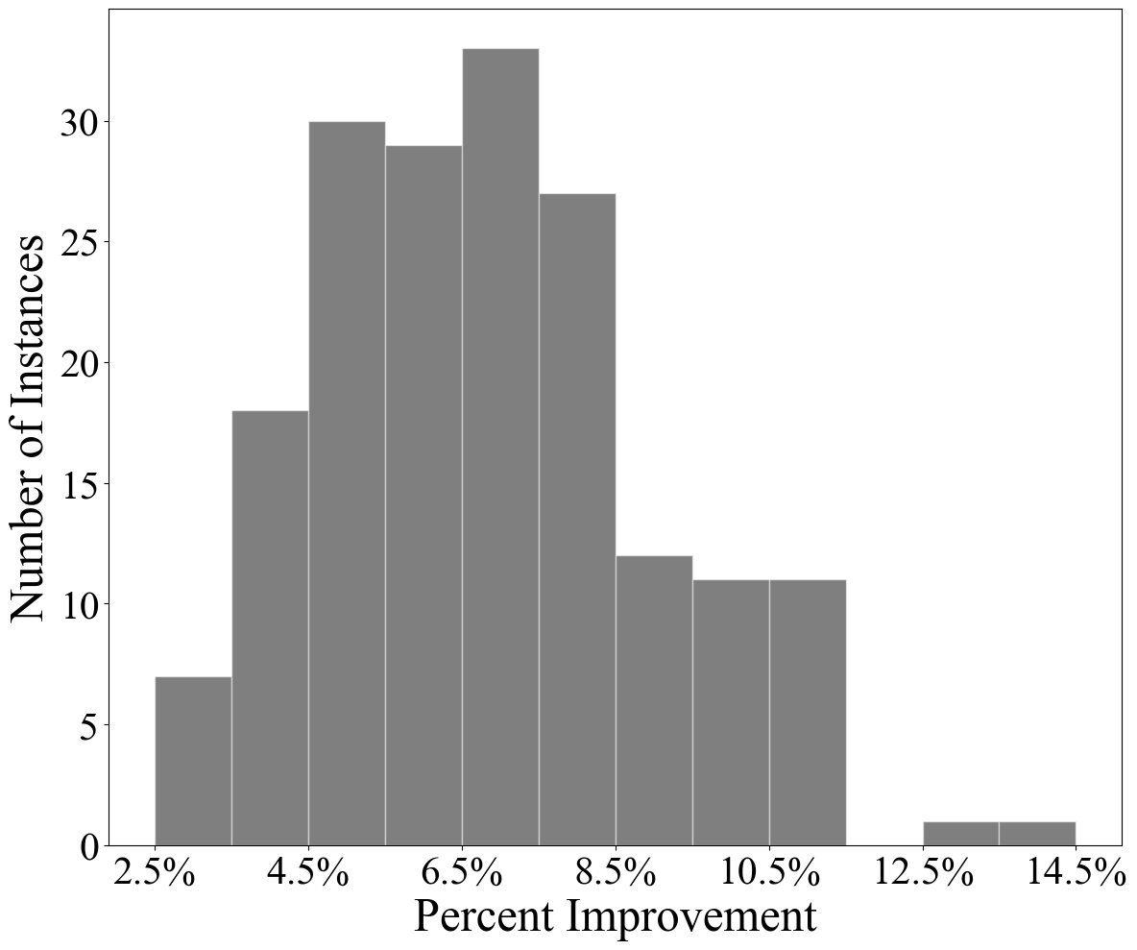
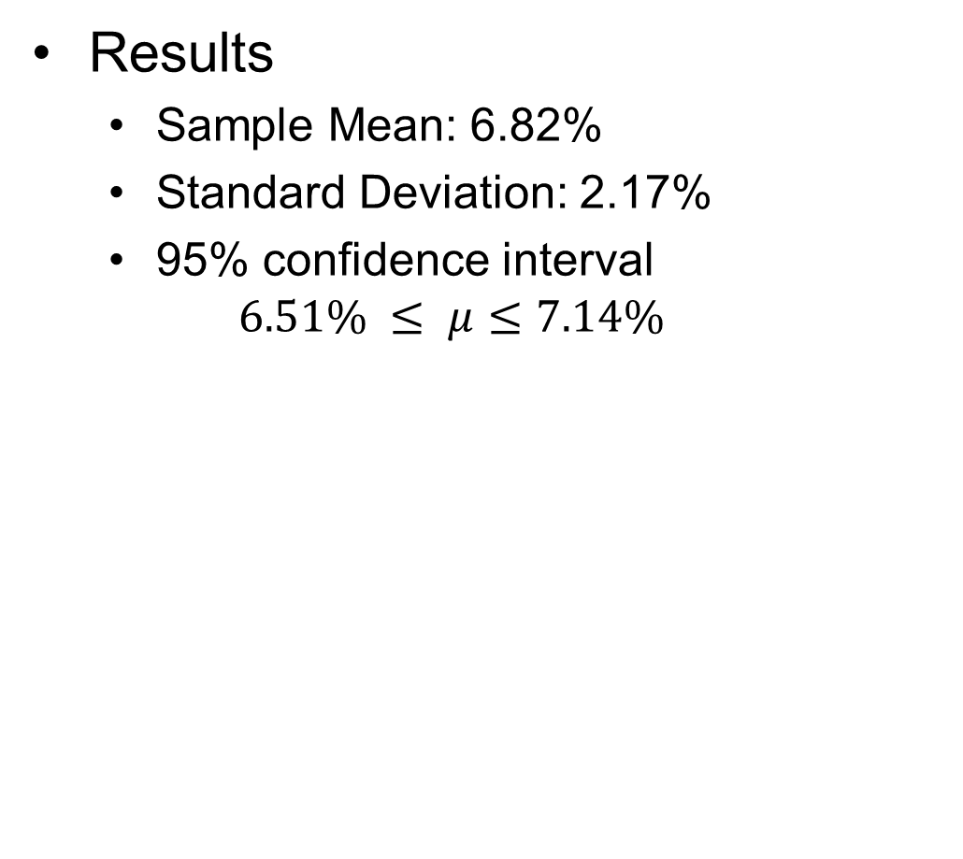
Model Comparison
Results
Sample Mean: 6.82%
Standard Deviation: 2.17%
95% confidence interval
$$6.51\% ≤ μ≤7.14\%$$

Slide 40
Conclusions
Summary
Optimization using a VFT framework more accurately captures decision-maker value trade-offs
Model is intuitive by nature
Metaheuristic solution technique incorporated to find better solutions quicker
Future Work
Better approximation techniques
More effective solution methodology (e.g., nonlinear optimization techniques)
More discussions with decision-makers on their values for solutions
More than one cadet objective

Slide 41
References
Andrew P. Armacost and James K. Lowe. Decision support for the career ﬁeld selection process at the US Air Force Academy. European Journal of Operational Research, 160(3):839–850, Feb 2005.
D. Gale and L. S. Shapley. College admissions and the stability of marriage. The American Mathematical Monthly, 69(1):9–15, Jan 1962.
Robert W. Irving, Paul Leather, and Dan Gusﬁeld. An eﬃcient algorithm for the “optimal” stable marriage. Journal of the ACM (JACM), 34(3):532–543, Jul 1987.
D. G. McVitie and L. B. Wilson. The stable marriage problem. Communications of the ACM, 14(7):486–490, Jul 1971.
Alvin E. Roth and Marilda Sotomayor. The college admissions problem revisited. Econometrica, 57(3):559, May 1989.
Pter Bir, Tams Fleiner, Robert W. Irving, and David F. Manlove. The college admissions problem with lower and common quotas. Theoretical Computer Science, 411(34-36):3136–3153, Jul 2010.
Dirk G. Cattrysse and Luk N. Van Wassenhove. A survey of algorithms for the generalized assignment problem. European Journal of Operational Research, 60(3):260–272, Aug 1992.
Ralph L. Keeney. Value-Focused Thinking: a path to creative decisionmaking. Long Range Planning, 30(2):314, 1997.

Slide 42
References
Ralph L. Keeney. Making better decision makers. Decision Analysis, 1(4):193–204, 2004.
Der San Chen, Robert G. Batson, and Yu Dang. Applied integer programming: modeling and solution. Applied Integer Programming: Modeling and Solution, Sep 2011.
Lei Xu, Maria Skoularidou, Alfredo Cuesta-Infante, and Kalyan Veeramachaneni. Modeling tabular data using conditional GAN.

Slide 43
Questions

Slide 44
Presentation Links
Problem Description
Modeling Techniques
Greedy Method
Stable Marriage Model
Assignment Problem
Original Methodology
Modeling Issues
Stable Marriage Model
Original Model
VFT Model
Objective Hierarchy
Formulation
Additional Subsets
Value Functions
Need for them
Creating them
Modeling them
Generating Parameters
Estimating Value Hierarchy
CTGAN Data Generation
Solution Methods
Model Complexity
Solver Selection
Solution Techniques
Genetic Algorithm
Model Comparison
Experiment Design
Results (% Improvement)
Results (% Similarity)
Instance Analysis
Instance Results
Cadet Utility Histogram
Utility Explanation
Sensitivity Analysis
Conclusions

Slide 45
Problem Description
AFSC Quotas
Each AFSC provides a range on the number of assigned cadets acceptable
Each AFSC may also specify a minimum number of cadets from each commissioning source
United States Air Force Academy (USAFA) cadets
Reserve Officer’s Training Corps (ROTC) cadets
Combined USAFA and ROTC targets (their sum) is the AFSC quota

Slide 46
Problem Description
AFSC Qualifications
Air Force Officer Classification Directory (AFOCD) outlines AFSC qualifications based on the cadets’ Classification of Instructional Programs (CIP) codes
Example AFOCD degree tier classification for the AFSC 35P, “Public Affairs”
Tier | Target | CIP | Program Description | Requirement
1 | ≥ 70% | 09.XXXX | Communication, Journalism and Related Programs | Mandatory
2 | ≥ 20% | 23.13XX | Rhetoric and Composition/Writing Studies | Desired
 |  | 42.XXXX | Psychology
 |  | 45.09XX | International Relations and National Security Studies
 |  | 45.10XX | Political Science and Government
 |  | 52.14XX | Marketing
3 | ≤ 10% | XX.XXXX | Any Degree | Permitted

Slide 47
Problem Description
“Balancing” Objectives
“Large” AFSCs should balance:
the distribution of lower performing cadets and higher performing cadets
the proportion of USAFA cadets should match that of the entire class
USAFA
ROTC
Entire Class
Assigned AFSCs

Slide 48
Problem Description
Cadet Preference
Cadets submit preferences and utility measures for the AFSCs they want
Example with three cadets, each with two preferences placed on four AFSCs
 | Choice 1 | Choice 2
Cadet 1 | 15A, 100% | 14N, 95%
Cadet 2 | 17D, 100% | 15A, 85%
Cadet 3 | 14N, 100% | 13N, 45%
 | 13N | 14N | 15A | 17D
Cadet 1 | 0 | 0.95 | 1 | 0
Cadet 2 | 0 | 0 | 0.85 | 1
Cadet 3 | 0.45 | 1 | 0 | 0

Slide 49
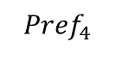
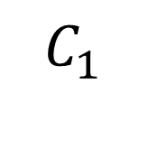
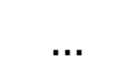
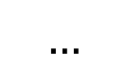
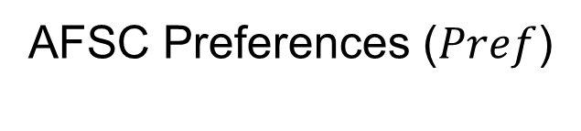
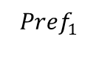
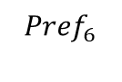
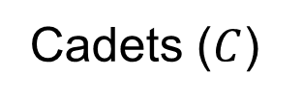
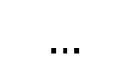
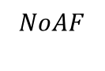
Modeling Techniques
Greedy Method
Cadets receive top choice available AFSC in order of merit
Only quotas and cadet preference are incorporated
Cadets ($C$)
AFSC Preferences ($Pref$)
$$C_{1}$$
$$…$$
$${Pref}_{4}$$
$$…$$
$$…$$
$${Pref}_{1}$$
$${Pref}_{6}$$
$$NoAF$$
NoAF: “Needs of the Air Force”

Slide 50
Modeling Techniques
Greedy Method
Cadets receive top choice available AFSC in order of merit
Only quotas and cadet preference are incorporated
Cadets ($C$)
AFSC Preferences ($Pref$)
$$C_{1}$$
$$…$$
$${Pref}_{4}$$
$$…$$
$$…$$
$${Pref}_{1}$$
$${Pref}_{6}$$
$$NoAF$$
NoAF: “Needs of the Air Force”

Slide 51
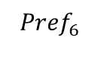
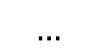
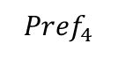

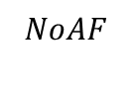
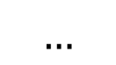
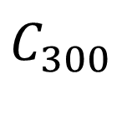
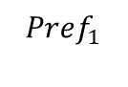
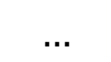
Modeling Techniques
Greedy Method
Cadets receive top choice available AFSC in order of merit
Only quotas and cadet preference are incorporated
Cadets ($C$)
AFSC Preferences ($Pref$)
$$C_{1}$$
$$…$$
$${Pref}_{4}$$
$$…$$
$$…$$
$${Pref}_{1}$$
$${Pref}_{6}$$
$$NoAF$$
$$…$$
$$C_{300}$$
$$…$$
$${Pref}_{4}$$
$$…$$
$$…$$
$${Pref}_{1}$$
$${Pref}_{6}$$
$$NoAF$$
NoAF: “Needs of the Air Force”

Slide 52
Modeling Techniques
Greedy Method
Cadets receive top choice available AFSC in order of merit
Only quotas and cadet preference are incorporated
Cadets ($C$)
AFSC Preferences ($Pref$)
$$C_{1}$$
$$…$$
$${Pref}_{4}$$
$$…$$
$$…$$
$${Pref}_{1}$$
$${Pref}_{6}$$
$$NoAF$$
$$…$$
$$C_{300}$$
$$…$$
$${Pref}_{4}$$
$$…$$
$$…$$
$${Pref}_{1}$$
$${Pref}_{6}$$
$$NoAF$$
NoAF: “Needs of the Air Force”

Slide 53
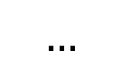

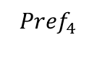
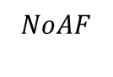
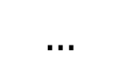
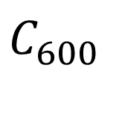
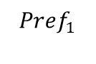
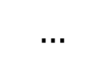
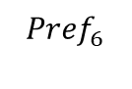
Modeling Techniques
Greedy Method
Cadets receive top choice available AFSC in order of merit
Only quotas and cadet preference are incorporated
Cadets ($C$)
AFSC Preferences ($Pref$)
$$C_{1}$$
$$…$$
$${Pref}_{4}$$
$$…$$
$$…$$
$${Pref}_{1}$$
$${Pref}_{6}$$
$$NoAF$$
$$…$$
$$C_{300}$$
$$…$$
$${Pref}_{4}$$
$$…$$
$$…$$
$${Pref}_{1}$$
$${Pref}_{6}$$
$$NoAF$$
$$…$$
$$C_{600}$$
$$…$$
$${Pref}_{4}$$
$$…$$
$$…$$
$${Pref}_{1}$$
$${Pref}_{6}$$
$$NoAF$$
NoAF: “Needs of the Air Force”

Slide 54
Modeling Techniques
Greedy Method
Cadets receive top choice available AFSC in order of merit
Only quotas and cadet preference are incorporated
Cadets ($C$)
AFSC Preferences ($Pref$)
$$C_{1}$$
$$…$$
$${Pref}_{4}$$
$$…$$
$$…$$
$${Pref}_{1}$$
$${Pref}_{6}$$
$$NoAF$$
$$…$$
$$C_{300}$$
$$…$$
$${Pref}_{4}$$
$$…$$
$$…$$
$${Pref}_{1}$$
$${Pref}_{6}$$
$$NoAF$$
$$…$$
$$C_{600}$$
$$…$$
$${Pref}_{4}$$
$$…$$
$$…$$
$${Pref}_{1}$$
$${Pref}_{6}$$
$$NoAF$$
NoAF: “Needs of the Air Force”

Slide 55
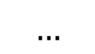
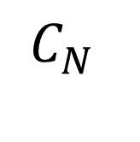
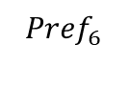
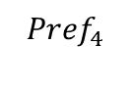
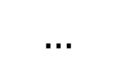
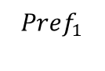
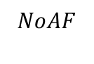

Modeling Techniques
Greedy Method
Cadets receive top choice available AFSC in order of merit
Only quotas and cadet preference are incorporated
Cadets ($C$)
AFSC Preferences ($Pref$)
$$C_{1}$$
$$…$$
$${Pref}_{4}$$
$$…$$
$$…$$
$${Pref}_{1}$$
$${Pref}_{6}$$
$$NoAF$$
$$…$$
$$C_{300}$$
$$…$$
$${Pref}_{4}$$
$$…$$
$$…$$
$${Pref}_{1}$$
$${Pref}_{6}$$
$$NoAF$$
$$…$$
$$C_{600}$$
$$…$$
$${Pref}_{4}$$
$$…$$
$$…$$
$${Pref}_{1}$$
$${Pref}_{6}$$
$$NoAF$$
$$…$$
$$C_{N}$$
$${Pref}_{1}$$
$$…$$
$${Pref}_{4}$$
$$…$$
$${Pref}_{6}$$
$$…$$
$$NoAF$$
NoAF: “Needs of the Air Force”

Slide 56
Modeling Techniques
Greedy Method
Cadets receive top choice available AFSC in order of merit
Only quotas and cadet preference are incorporated
Cadets ($C$)
AFSC Preferences ($Pref$)
$$C_{1}$$
$$…$$
$${Pref}_{4}$$
$$…$$
$$…$$
$${Pref}_{1}$$
$${Pref}_{6}$$
$$NoAF$$
$$…$$
$$C_{300}$$
$$…$$
$${Pref}_{4}$$
$$…$$
$$…$$
$${Pref}_{1}$$
$${Pref}_{6}$$
$$NoAF$$
$$…$$
$$C_{600}$$
$$…$$
$${Pref}_{4}$$
$$…$$
$$…$$
$${Pref}_{1}$$
$${Pref}_{6}$$
$$NoAF$$
$$…$$
$$C_{N}$$
$${Pref}_{1}$$
$$…$$
$${Pref}_{4}$$
$$…$$
$${Pref}_{6}$$
$$…$$
$$NoAF$$
NoAF: “Needs of the Air Force”

Slide 57
Modeling Techniques
Greedy Method
Cadets receive top choice available AFSC in order of merit
Only quotas and cadet preference are incorporated
Cadets ($C$)
AFSC Preferences ($Pref$)
$$C_{1}$$
$$…$$
$${Pref}_{4}$$
$$…$$
$$…$$
$${Pref}_{1}$$
$${Pref}_{6}$$
$$NoAF$$
$$…$$
$$C_{300}$$
$$…$$
$${Pref}_{4}$$
$$…$$
$$…$$
$${Pref}_{1}$$
$${Pref}_{6}$$
$$NoAF$$
$$…$$
$$C_{600}$$
$$…$$
$${Pref}_{4}$$
$$…$$
$$…$$
$${Pref}_{1}$$
$${Pref}_{6}$$
$$NoAF$$
$$…$$
$$C_{N}$$
$${Pref}_{1}$$
$$…$$
$${Pref}_{4}$$
$$…$$
$${Pref}_{6}$$
$$…$$
$$NoAF$$
NoAF: “Needs of the Air Force”

Slide 58
Modeling Techniques
The Stable Marriage/Matching Problem (One-to-One)
Two sets of entities place preferences for each other
Goal is to find a stable match: no two members of opposite sets prefer each other to their assigned match
Stable Marriage Algorithm, invented by David Gale and Lloyd Shapley [2], ensures such a match
Set 1 (Males)
Set 2 (Females)

Slide 59
Modeling Techniques
The Stable Marriage/Matching Problem (One-to-One)
Two sets of entities place preferences for each other
Goal is to find a stable match: no two members of opposite sets prefer each other to their assigned match
Stable Marriage Algorithm, invented by David Gale and Lloyd Shapley [2], ensures such a match
(Stable)
Set 1 (Males)
A
B
A
B
Set 2 (Females)
Preferred Partner

Slide 60
Modeling Techniques
The Stable Marriage/Matching Problem (One-to-One)
Two sets of entities place preferences for each other
Goal is to find a stable match: no two members of opposite sets prefer each other to their assigned match
Stable Marriage Algorithm, invented by David Gale and Lloyd Shapley [2], ensures such a match
(Unstable)
Set 1 (Males)
A
B
A
B
Set 2 (Females)
Preferred Partner

Slide 61
Modeling Techniques
The Stable Marriage/Matching Problem (One-to-One)
Two sets of entities place preferences for each other
Goal is to find a stable match: no two members of opposite sets prefer each other to their assigned match
Stable Marriage Algorithm, invented by David Gale and Lloyd Shapley [2], ensures such a match
Set 1 (Males)
Set 2 (Females)

Slide 62
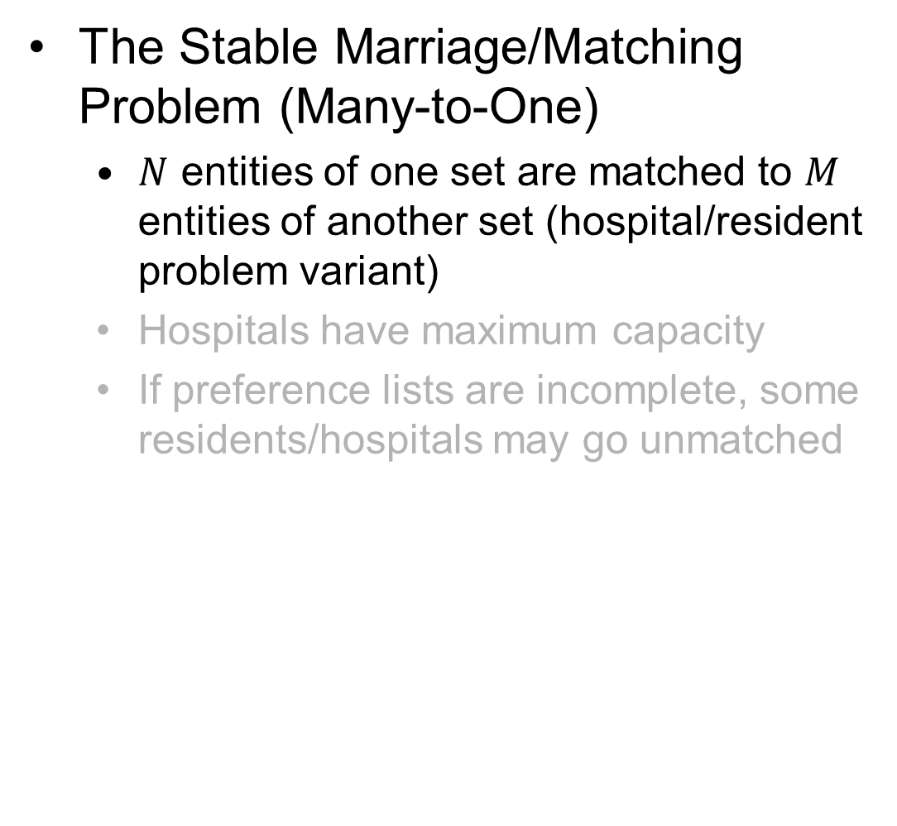
Modeling Techniques
The Stable Marriage/Matching Problem (Many-to-One)
$N$ entities of one set are matched to $M$ entities of another set (hospital/resident problem variant)
Hospitals have maximum capacity
If preference lists are incomplete, some residents/hospitals may go unmatched
Set 1 (Residents)
Set 2 (Hospitals)

Slide 63

Modeling Techniques
The Stable Marriage/Matching Problem (Many-to-One)
$N$ entities of one set are matched to $M$ entities of another set (hospital/resident problem variant)
Hospitals have maximum capacity
If preference lists are incomplete, some residents/hospitals may go unmatched
Set 1 (Residents)
Set 2 (Hospitals)

Slide 64

Modeling Techniques
The Stable Marriage/Matching Problem (Many-to-One)
$N$ entities of one set are matched to $M$ entities of another set (hospital/resident problem variant)
Hospitals have maximum capacity
If preference lists are incomplete, some residents/hospitals may go unmatched
Set 1 (Residents)
Set 2 (Hospitals)

Slide 65

Modeling Techniques
The Assignment Problem
The generalized assignment problem found in the literature [7]
Current model uses this formulation

Slide 66
Modeling Techniques
The Assignment Problem
The generalized assignment problem found in the literature [7]
Current model uses this formulation

Slide 67

Modeling Techniques
The Assignment Problem
The generalized assignment problem found in the literature [7]
Current model uses this formulation

Slide 68

Modeling Techniques
The Assignment Problem
The generalized assignment problem found in the literature [7]
Current model uses this formulation

Slide 69
Original Methodology
The AFSC/Cadet Assignment Problem Formulation
Model follows generalized assignment problem formulation with new Air Force constraints
Objective is to maximize global utility

Slide 70
Original Methodology
The AFSC/Cadet Assignment Problem Formulation
Model follows generalized assignment problem formulation with new Air Force constraints
Objective is to maximize global utility

Slide 71

Original Methodology
The AFSC/Cadet Assignment Problem Formulation
Model follows generalized assignment problem formulation with new Air Force constraints
Objective is to maximize global utility

Slide 72

Original Methodology
The AFSC/Cadet Assignment Problem Formulation
Model follows generalized assignment problem formulation with new Air Force constraints
Objective is to maximize global utility

Slide 73

Original Methodology
The AFSC/Cadet Assignment Problem Formulation
Model follows generalized assignment problem formulation with new Air Force constraints
Objective is to maximize global utility

Slide 74

Original Methodology
The AFSC/Cadet Assignment Problem Formulation
Model follows generalized assignment problem formulation with new Air Force constraints
Objective is to maximize global utility

Slide 75

Original Methodology
The AFSC/Cadet Assignment Problem Formulation
Model follows generalized assignment problem formulation with new Air Force constraints
Objective is to maximize global utility

Slide 76
Original Methodology
The AFSC/Cadet Assignment Problem Formulation
Model follows generalized assignment problem formulation with new Air Force constraints
Objective is to maximize global utility

Slide 77
Original Methodology
The AFSC/Cadet Assignment Problem Formulation
Model follows generalized assignment problem formulation with new Air Force constraints
Objective is to maximize global utility

Slide 78
Original Methodology
The AFSC/Cadet Assignment Problem Formulation
Model follows generalized assignment problem formulation with new Air Force constraints
Objective is to maximize global utility

Slide 79


Original Methodology
The AFSC/Cadet Assignment Problem Formulation
Model follows generalized assignment problem formulation with new Air Force constraints
Objective is to maximize global utility

Slide 80
Modeling Issues
Issues with Stable Marriage for AFSC/Cadet Problem
Preferences are ordinal rankings, not utility measures
Incomplete preference lists do not work
AFSC constraints are a problem
1
2
3
…
vs
100%
90%
75%
…

Slide 81
Modeling Issues
Issues with Stable Marriage for AFSC/Cadet Problem
Preferences are ordinal rankings, not utility measures
Incomplete preference lists do not work
AFSC constraints are a problem
Cadet A’s Preferences
AFSC
Rank
15A
1
14N
2
63A
3
17D
4

Slide 82
Modeling Issues
Issues with Stable Marriage for AFSC/Cadet Problem
Preferences are ordinal rankings, not utility measures
Incomplete preference lists do not work
AFSC constraints are a problem

Slide 83
Modeling Issues
Problem Assumptions
Ordinal rankings are used
Only upper bounds on the allowable number of residents are given
Objective is to find a stable match
Issues with the Stable Marriage Algorithm
Finds “male-optimal” solution, since the men get to propose to their top choices and women only get to accept their best offer [4]
No guaranteed global optimal solution (only stable solution) [5]
“Group-stability” in the case of many-to-one matching refers to the hospital’s preference over the group of residents, rather than individuals. This leads to strong and weak stability, further complicating the problem [6]
Lower bounds result in the potential for no stable matching [7]

Slide 84


Modeling Issues
Issues with Stable Marriage for AFSC/Cadet Problem
Cadets have no way of providing trade offs/indifference measures between AFSCs
Only ordinal rankings are used
Does not capture true value/utility gained from AFSC received
Incomplete preference lists
Cadets traditionally submit 6 preferences
Does the stable marriage model use incomplete preferences? This would mean cadets can only be assigned AFSCs on their lists. Likely this would not be the case, so the remaining ~26 AFSCs would be arbitrarily sorted for each cadet, which is not accurate
With a utility matrix, AFSCs for which a cadet has placed a utility of 0 will all equally be undesirable. In the stable marriage context, preference 7 $≻$ preference 8 $≻$ preference 9 … etc.
$≻$ = “is preferred to” or “succeeds”

Slide 85
Modeling Issues
Issues with Stable Marriage for AFSC/Cadet Problem
Constraints
Given the numerous objectives/constraints that are specified, how does the algorithm ensure these criteria are met?
Quotas are easy, but what about balancing AFOCD proportions, merit, source of commissioning, etc.?
Hospital/Residents problem allows for quotas to go unfilled and some residents to not be matched to hospitals and vice versa, which is not acceptable for the AFSC/Cadet problem
No objective function by which to compare solutions

Slide 86











Modeling Issues
Original Model Issues
AFSCs prefer solution sets of cadets, not cadets individually
Eligible Cadets for AFSC “15A”
15A Preference List
$$C_{1}$$
$$C_{2}$$
$$C_{3}$$
Cadet
Rank
Degree: “Desired”
15A Utility: 75%
Percentile: 90%
SOC: USAFA
Degree: “Mandatory”
15A Utility: 40%
Percentile: 35%
SOC: ROTC
Degree: “Permitted”
15A Utility: 100%
Percentile: 75%
SOC: ROTC
$$C_{1}$$
?
$$C_{2}$$
?
$$C_{4}$$
$$C_{5}$$
$$C_{6}$$
$$C_{3}$$
?
Degree: “Mandatory”
15A Utility: 20%
Percentile: 85%
SOC: ROTC
Degree: “Permitted”
15A Utility: 60%
Percentile: 20%
SOC: USAFA
Degree: “Desired”
15A Utility: 30%
Percentile: 60%
SOC: ROTC
$$C_{4}$$
?
$$C_{5}$$
?
$$C_{6}$$
?
SOC = “Source of Commissioning”

Slide 87






Modeling Issues
Original Model Issues
AFSCs prefer solution sets of cadets, not cadets individually
Eligible Cadets for AFSC “15A”
15A Solution 1
15A Solution 2
$$C_{1}$$
$$C_{2}$$
$$C_{3}$$
Degree: “Desired”
15A Utility: 75%
Percentile: 90%
SOC: USAFA
Degree: “Mandatory”
15A Utility: 40%
Percentile: 35%
SOC: ROTC
Degree: “Permitted”
15A Utility: 100%
Percentile: 75%
SOC: ROTC
$$C_{1}$$
$$C_{2}$$
$$C_{3}$$
$$C_{4}$$
$$C_{2}$$
$$C_{5}$$
$$C_{6}$$
Average Merit: 0.7125
USAFA Proportion: 0.25
Mandatory Proportion: 0.5
Desired Proportion: 0.25
Permitted Proportion: 0.25
Average Utility: 0.5875
Number of Cadets: 4
Average Merit: 0.383
USAFA Proportion: 0.33
Mandatory Proportion: 0.33
Desired Proportion: 0.33
Permitted Proportion: 0.33
Average Utility: 0.433
Number of Cadets: 3
$$C_{4}$$
$$C_{5}$$
$$C_{6}$$
Degree: “Mandatory”
15A Utility: 20%
Percentile: 85%
SOC: ROTC
Degree: “Permitted”
15A Utility: 60%
Percentile: 20%
SOC: USAFA
Degree: “Desired”
15A Utility: 30%
Percentile: 60%
SOC: ROTC
SOC = “Source of Commissioning”

Slide 88




Modeling Issues
Original Model Issues
AFSCs prefer solution sets of cadets, not cadets individually
Eligible Cadets for AFSC “15A”
15A Solution 1
15A Solution 2
$$C_{1}$$
$$C_{2}$$
$$C_{3}$$
Degree: “Desired”
15A Utility: 75%
Percentile: 90%
SOC: USAFA
Degree: “Mandatory”
15A Utility: 40%
Percentile: 35%
SOC: ROTC
Degree: “Permitted”
15A Utility: 100%
Percentile: 75%
SOC: ROTC
$$C_{1}$$
$$C_{2}$$
$$C_{3}$$
$$C_{4}$$
$$C_{2}$$
$$C_{5}$$
$$C_{6}$$
Average Merit: 0.7125
USAFA Proportion: 0.25
Mandatory Proportion: 0.5
Desired Proportion: 0.25
Permitted Proportion: 0.25
Average Utility: 0.5875
Number of Cadets: 4
Average Merit: 0.383
USAFA Proportion: 0.33
Mandatory Proportion: 0.33
Desired Proportion: 0.33
Permitted Proportion: 0.33
Average Utility: 0.433
Number of Cadets: 3
$$C_{4}$$
$$C_{5}$$
$$C_{6}$$
Degree: “Mandatory”
15A Utility: 20%
Percentile: 85%
SOC: ROTC
Degree: “Permitted”
15A Utility: 60%
Percentile: 20%
SOC: USAFA
Degree: “Desired”
15A Utility: 30%
Percentile: 60%
SOC: ROTC
SOC = “Source of Commissioning”

Slide 89
Modeling Issues
Original Model Issues
AFSCs prefer solution sets of cadets, not cadets individually
Eligible Cadets for AFSC “15A”
15A Solution 1
15A Solution 2
$$C_{1}$$
$$C_{2}$$
$$C_{3}$$
Degree: “Desired”
15A Utility: 75%
Percentile: 90%
SOC: USAFA
Degree: “Mandatory”
15A Utility: 40%
Percentile: 35%
SOC: ROTC
Degree: “Permitted”
15A Utility: 100%
Percentile: 75%
SOC: ROTC
$$C_{1}$$
$$C_{2}$$
$$C_{3}$$
$$C_{4}$$
$$C_{2}$$
$$C_{5}$$
$$C_{6}$$
Average Merit: 0.7125
USAFA Proportion: 0.25
Mandatory Proportion: 0.5
Desired Proportion: 0.25
Permitted Proportion: 0.25
Average Utility: 0.5875
Number of Cadets: 4
Average Merit: 0.383
USAFA Proportion: 0.33
Mandatory Proportion: 0.33
Desired Proportion: 0.33
Permitted Proportion: 0.33
Average Utility: 0.433
Number of Cadets: 3
$$C_{4}$$
$$C_{5}$$
$$C_{6}$$
Degree: “Mandatory”
15A Utility: 20%
Percentile: 85%
SOC: ROTC
Degree: “Permitted”
15A Utility: 60%
Percentile: 20%
SOC: USAFA
Degree: “Desired”
15A Utility: 30%
Percentile: 60%
SOC: ROTC
SOC = “Source of Commissioning”

Slide 90

Modeling Issues
Original Model Issues
USAFA Proportion and Average Merit constraints are not accurate
The denominator should be replaced with the sum of all cadets assigned to the AFSC, not the target number of assigned cadets for the AFSC

Slide 91
Modeling Issues
Original Model Issues
USAFA Proportion and Average Merit constraints are not accurate
The denominator should be replaced with the sum of all cadets assigned to the AFSC, not the target number of assigned cadets for the AFSC

Slide 92
Modeling Issues
Original Model Issues
USAFA Proportion and Average Merit constraints are not accurate
The denominator should be replaced with the sum of all cadets assigned to the AFSC, not the target number of assigned cadets for the AFSC

Slide 93
Modeling Issues
Original Model Issues
The constraints almost always result in infeasible solutions

Slide 94
Modeling Issues
Original Model Issues
The utility function does not accurately depict real AFSC/Cadet utilities
Arbitrary value specifications
Inconsistencies in values
All AFSCs are assumed to be the same
AFSC objectives are blended
Big M does not always constrain eligibility

Slide 95
Modeling Issues
Original Model Issues
The utility function does not accurately depict real AFSC/Cadet utilities
Arbitrary value specifications
Inconsistencies in values
All AFSCs are assumed to be the same
AFSC objectives are blended
Big M does not always constrain eligibility

Slide 96
Modeling Issues
Original Model Issues
The utility function does not accurately depict real AFSC/Cadet utilities
Arbitrary value specifications
Inconsistencies in values
All AFSCs are assumed to be the same
AFSC objectives are blended
Big M does not always constrain eligibility

Slide 97
Modeling Issues
Original Model Issues
The utility function does not accurately depict real AFSC/Cadet utilities
Arbitrary value specifications
Inconsistencies in values
All AFSCs are assumed to be the same
AFSC objectives are blended
Big M does not always constrain eligibility

Slide 98
Modeling Issues
Original Model Issues
The utility function does not accurately depict real AFSC/Cadet utilities
Arbitrary value specifications
Inconsistencies in values
All AFSCs are assumed to be the same
AFSC objectives are blended
Big M does not always constrain eligibility
(for all cadets and AFSCs)

Slide 99
Modeling Issues
Original Model Issues
The utility function does not accurately depict real AFSC/Cadet utilities
Arbitrary value specifications
Inconsistencies in values
All AFSCs are assumed to be the same
AFSC objectives are blended
Big M does not always constrain eligibility

Slide 100
Modeling Issues
Original Model Issues
The utility function does not accurately depict real AFSC/Cadet utilities
Arbitrary value specifications
Inconsistencies in values
All AFSCs are assumed to be the same
AFSC objectives are blended
Big M does not always constrain eligibility

Slide 101

Modeling Issues
Original Model Issues
The constraints almost always result in infeasible solutions

Slide 102

Modeling Issues
Original Model Issues
AFSCs are not the same

Slide 103

Modeling Issues
Original Model Issues
AFSCs are not the same

Slide 104

Modeling Issues
Original Model Issues
Two different objectives represented by USAFA constraint
Constrained minimum number of USAFA cadets
Constrained USAFA proportion
Example
Targets
USAFA Quota: 2 cadets
ROTC Quota: 6 cadets
Combined Quota: 8 cadets
Maximum: 14 cadets
2 USAFA cadets,
8 ROTC cadets
10 Total cadets
20%
USAFA
80%
ROTC
Entire Class
AFSC Solution
These are separate objectives!

Slide 105
VFT Model
Reforming the Problem
Stable Marriage/Assignment Problem applications lack proper value-specification
Current model uses Alternative-Focused Thinking (AFT), not Value-Focused Thinking (VFT) [8]

Slide 106
VFT Model
Reforming the Problem
Stable Marriage/Assignment Problem applications lack proper value-specification
Current model uses Alternative-Focused Thinking (AFT), not Value-Focused Thinking (VFT) [8]
AFT
VFT
Solutions generated based on values
Solutions generated
Values determined to measure solutions
Alternative 1
Values determined
Alternative 1
Alternative 2
Values
Values
Alternative 2
Alternative 3
Alternative 3

Slide 107


VFT Model
Optimization Model
Sets and Indices
Three main sets of entities
New set for AFSC objectives
Cadet/AFSC constraint subsets

Slide 108
VFT Model
Optimization Model
Sets and Indices
Three main sets of entities
New set for AFSC objectives
Cadet/AFSC constraint subsets
Cadet/AFSC eligibility subsets

Slide 109
VFT Model
Optimization Model
Sets and Indices
Three main sets of entities
New set for AFSC objectives
Cadet/AFSC constraint subsets
Cadet/AFSC eligibility subsets
AFSC objective subsets

Slide 110
VFT Model
Optimization Model
Sets and Indices
Three main sets of entities
New set for AFSC objectives
Cadet/AFSC constraint subsets
Cadet/AFSC eligibility subsets
AFSC objective subsets
AFSC objective constraint subsets

Slide 111
VFT Model
Optimization Model
Sets and Indices
Three main sets of entities
New set for AFSC objectives
Cadet/AFSC constraint subsets
Cadet/AFSC eligibility subsets
AFSC objective subsets
AFSC objective constraint subsets
AFSC demographic objective subset
…
…

Slide 112
VFT Model
Optimization Model
Sets and Indices
Three main sets of entities
New set for AFSC objectives
Cadet/AFSC constraint subsets
Cadet/AFSC eligibility subsets
AFSC objective subsets
AFSC objective constraint subsets
AFSC demographic objective subset
Cadets (with demographic corresponding to objective) subsets
…
…

Slide 113

Need For Value Functions
Value Hierarchy
Value Functions
Combined Quota Objective
Notes:
I’ve discussed the need for AFSC objective values, but how do we model them? I use exponential piecewise functions because I believe they best capture DM trade-offs in values for a given AFSC objective. To illustrate this, as well as show the need for these kinds of functions, I’m going to step through some examples for the “Quota” objective.

Slide 114

Need For Value Functions
Value Hierarchy
Value Functions
Combined Quota Objective
Lower and upper bound given
Notes:
Let’s say a decision maker specifies a quota of 60 cadets, with an upper bound of 90. We haven’t defined any sort of value trade-off, just a constraint.

Slide 115

Need For Value Functions
Value Hierarchy
Value Functions
Combined Quota Objective
Lower and upper bound given
Constraint can be modeled by a “binary” value function
Notes:
This is how constraints work! Talk about how this really doesn’t capture true value trade-offs in the solution. A simple 1 or 0 grossly misrepresents the problem, and there should be more trade-offs considered by the model. Is 59 cadets really that bad? Or 91? Probably not

Slide 116

Need For Value Functions
Value Hierarchy
Value Functions
Combined Quota Objective
Lower and upper bound given
Constraint can be modeled by a “binary” value function
Simple linear relationship

Slide 117

Need For Value Functions
Value Hierarchy
Value Functions
Combined Quota Objective
Lower and upper bound given
Constraint can be modeled by a “binary” value function
Simple linear relationship
Relationship is most likely non-linear

Slide 118

Need For Value Functions
Value Hierarchy
Value Functions
Combined Quota Objective
Lower and upper bound given
Constraint can be modeled by a “binary” value function
Simple linear relationship
Relationship is most likely non-linear

Slide 119

Need For Value Functions
Value Hierarchy
Value Functions
Combined Quota Objective
Lower and upper bound given
Constraint can be modeled by a “binary” value function
Simple linear relationship
Relationship is most likely non-linear
Estimating past value functions
Notes:
For past class years, I knew what the quotas were and what ultimately got implemented within the solution (sometimes the constraints weren’t met).

Slide 120

Need For Value Functions
Value Hierarchy
Value Functions
Combined Quota Objective
Lower and upper bound given
Constraint can be modeled by a “binary” value function
Simple linear relationship
Relationship is most likely non-linear
Estimating past value functions
Notes:
For example, let’s say the original constraint (as mentioned in the SAS code) was to fall within 60, 90 cadets, but the constraint was commented out and 120 cadets were ultimately assigned. I handled this one of two ways

Slide 121

Need For Value Functions
Value Hierarchy
Value Functions
Combined Quota Objective
Lower and upper bound given
Constraint can be modeled by a “binary” value function
Simple linear relationship
Relationship is most likely non-linear
Estimating past value functions
Notes:
I could simply adjust the “preferred/indifference” range so that objective measures ranging from 60 to 120 would all be equally desirable

Slide 122

Need For Value Functions
Value Hierarchy
Value Functions
Combined Quota Objective
Lower and upper bound given
Constraint can be modeled by a “binary” value function
Simple linear relationship
Relationship is most likely non-linear
Estimating past value functions
Notes:
Or, I keep the same constraint, but still maintain the original indifference range. Value of 0.5 at 120. Value function is distinguishable from constraint. This is really useful!

Slide 123
Need For Value Functions
Value Hierarchy
Value Functions
Combined Quota Objective
Lower and upper bound given
Constraint can be modeled by a “binary” value function
Simple linear relationship
Relationship is most likely non-linear
Estimating past value functions
Future value function potential
Notes:
Talk about how career field managers should/could model value functions in the future

Slide 124

Need For Value Functions
Value Hierarchy
Value Functions
Combined Quota Objective
Lower and upper bound given
Constraint can be modeled by a “binary” value function
Simple linear relationship
Relationship is most likely non-linear
Estimating past value functions
Future value function potential
Notes:
Talk about how career field managers should/could model value functions in the future

Slide 125

Need For Value Functions
Value Hierarchy
Value Functions
Combined Quota Objective
Lower and upper bound given
Constraint can be modeled by a “binary” value function
Simple linear relationship
Relationship is most likely non-linear
Estimating past value functions
Future value function potential
Notes:
Talk about how career field managers should/could model value functions in the future

Slide 126

Need For Value Functions
Value Hierarchy
Value Functions
Combined Quota Objective
Lower and upper bound given
Constraint can be modeled by a “binary” value function
Simple linear relationship
Relationship is most likely non-linear
Estimating past value functions
Future value function potential
Notes:
Talk about how career field managers should/could model value functions in the future

Slide 127

Need For Value Functions
Value Hierarchy
Value Functions
Combined Quota Objective
Lower and upper bound given
Constraint can be modeled by a “binary” value function
Simple linear relationship
Relationship is most likely non-linear
Estimating past value functions
Future value function potential
Notes:
Talk about how career field managers should/could model value functions in the future

Slide 128

Need For Value Functions
Value Hierarchy
Value Functions
Combined Quota Objective
Lower and upper bound given
Constraint can be modeled by a “binary” value function
Simple linear relationship
Relationship is most likely non-linear
Estimating past value functions
Future value function potential
Notes:
Talk about how career field managers should/could model value functions in the future

Slide 129

Need For Value Functions
Value Hierarchy
Creating Value Functions
Combined Quota Objective
Lower and upper bound given
Constraint can be modeled by a “binary” value function
Simple linear relationship
Relationship is most likely non-linear
Estimating past value functions
Future value function potential
Nonlinear function can be linearized using “breakpoints”
Notes:
Talk about how career field managers should/could model value functions in the future

Slide 130


Creating Value Functions
Value Hierarchy
Creating Value Functions
Assume exponential value relationship
$$y= \frac{1 −e^{\frac{−(x −x_{i})}{ρ}}}{1−e^{\frac{−(x_{f} −x_{i})}{ρ}}}$$

Slide 131

Creating Value Functions
Value Hierarchy
Creating Value Functions
Assume exponential value relationship
$$y= \frac{1 −e^{\frac{−(x −0)}{ρ}}}{1−e^{\frac{−(10 − 0)}{ρ}}}$$

Slide 132

Creating Value Functions
Value Hierarchy
Creating Value Functions
Assume exponential value relationship
$$y= \frac{1 −e^{\frac{−x}{ρ}}}{1−e^{\frac{−10}{ρ}}}$$

Slide 133
Creating Value Functions
Value Hierarchy
Creating Value Functions
Assume exponential value relationship
$$y= \frac{1 −e^{\frac{−x}{ρ}}}{1−e^{\frac{−10}{ρ}}}$$

Slide 134

Creating Value Functions
Value Hierarchy
Creating Value Functions
Assume exponential value relationship
$$y= \frac{1 −e^{\frac{−x}{−2}}}{1−e^{\frac{−10}{−2}}}$$

Slide 135


Creating Value Functions
Value Hierarchy
Creating Value Functions
Assume exponential value relationship
$$y= \frac{1 −e^{\frac{−x}{−4}}}{1−e^{\frac{−10}{−4}}}$$

Slide 136


Creating Value Functions
Value Hierarchy
Creating Value Functions
Assume exponential value relationship
$$y= \frac{1 −e^{\frac{−x}{−0.5}}}{1−e^{\frac{−10}{−0.5}}}$$

Slide 137


Creating Value Functions
Value Hierarchy
Creating Value Functions
Assume exponential value relationship
$$y= \frac{1 −e^{\frac{−x}{2}}}{1−e^{\frac{−10}{2}}}$$

Slide 138

Creating Value Functions
Value Hierarchy
Creating Value Functions
Assume exponential value relationship
Piece-wise exponential value functions are implemented

Slide 139

Creating Value Functions
Value Hierarchy
Creating Value Functions
Assume exponential value relationship
Piece-wise exponential value functions are implemented

Slide 140

Creating Value Functions
Value Hierarchy
Creating Value Functions
Assume exponential value relationship
Piece-wise exponential value functions are implemented

Slide 141

Creating Value Functions
Value Hierarchy
Creating Value Functions
Assume exponential value relationship
Piece-wise exponential value functions are implemented

Slide 142


Creating Value Functions
Value Hierarchy
Creating Value Functions
Assume exponential value relationship
Piece-wise exponential value functions are implemented
Segment “breakpoints” are incorporated to connect each exponential function

Slide 143

Creating Value Functions
Value Hierarchy
Creating Value Functions
Assume exponential value relationship
Piece-wise exponential value functions are implemented
Segment “breakpoints” are incorporated to connect each exponential function

Slide 144


Creating Value Functions
Value Hierarchy
Creating Value Functions
Assume exponential value relationship
Piece-wise exponential value functions are implemented
Segment “breakpoints” are incorporated to connect each exponential function
Non-linear function is linearized based on the number of breakpoints required

Slide 145

Creating Value Functions
Value Hierarchy
Creating Value Functions
Assume exponential value relationship
Piece-wise exponential value functions are implemented
Segment “breakpoints” are incorporated to connect each exponential function
Non-linear function is linearized based on the number of breakpoints required

Slide 146

Creating Value Functions
Value Hierarchy
Creating Value Functions
Assume exponential value relationship
Piece-wise exponential value functions are implemented
Segment “breakpoints” are incorporated to connect each exponential function
Non-linear function is linearized based on the number of breakpoints required

Slide 147
Creating Value Functions
Value Hierarchy
Creating Value Functions
Assume exponential value relationship
Piece-wise exponential value functions are implemented
Segment “breakpoints” are incorporated to connect each exponential function
Non-linear function is linearized based on the number of breakpoints required

Slide 148

Creating Value Functions
Value Hierarchy
Creating Value Functions
Assume exponential value relationship
Piece-wise exponential value functions are implemented
Segment “breakpoints” are incorporated to connect each exponential function
Non-linear function is linearized based on the number of breakpoints required

Slide 149

Creating Value Functions
Value Hierarchy
Creating Value Functions
Assume exponential value relationship
Piece-wise exponential value functions are implemented
Segment “breakpoints” are incorporated to connect each exponential function
Non-linear function is linearized based on the number of breakpoints required

Slide 150


Modeling Value Functions
Value Hierarchy
Modeling Value Functions [10]

Slide 151



Modeling Value Functions
Value Hierarchy
Modeling Value Functions [10]
3
2
4
1
5

Slide 152

Modeling Value Functions
Value Hierarchy
Modeling Value Functions [10]
3
2
4
1
5

Slide 153



Modeling Value Functions
Value Hierarchy
Modeling Value Functions [10]
2

Slide 154

Modeling Value Functions
Value Hierarchy
Modeling Value Functions [10]
Breakpoint
1
2
3
4
5
0.0
0.2
0.5
0.8
1.0
Measure

Slide 155
Modeling Value Functions
Value Hierarchy
Modeling Value Functions [10]
Breakpoint
1
2
3
4
5
0.0
0.2
0.4
0.5
0.8
1.0
Measure

Slide 156

Modeling Value Functions
Value Hierarchy
Modeling Value Functions [10]
Breakpoint
1
2
3
4
5
0.0
0.2
0.4
0.5
0.8
1.0
Measure
$$λ_{jk2}=\frac{0.5−0.4}{0.5−0.2}=\frac{1}{3}$$

Slide 157

Modeling Value Functions
Value Hierarchy
Modeling Value Functions [10]
Breakpoint
1
2
3
4
5
0.0
0.2
0.4
0.5
0.8
1.0
Measure
$$y_{jk2}=1$$

Slide 158


Modeling Value Functions
Value Hierarchy
Modeling Value Functions [10]

Slide 159

Modeling Value Functions
Value Hierarchy
Modeling Value Functions [10]

Slide 160

Modeling Value Functions
Value Hierarchy
Modeling Value Functions [10]

Slide 161

Modeling Value Functions
Value Hierarchy
Modeling Value Functions [10]

Slide 162

Estimating Value Hierarchy
Value Hierarchy
Estimating Value Functions
Functions depend on the set of eligible cadets for each AFSC
Example AFSC Value Functions

Slide 163

Estimating Value Hierarchy
Value Hierarchy
Estimating Value Functions
Functions depend on the set of eligible cadets for each AFSC
Example AFSC Value Functions

Slide 164

Estimating Value Hierarchy
Value Hierarchy
Estimating Value Functions
Functions depend on the set of eligible cadets for each AFSC
Example AFSC Value Functions

Slide 165

Estimating Value Hierarchy
Value Hierarchy
Estimating Value Functions
Functions depend on the set of eligible cadets for each AFSC
Example AFSC Value Functions

Slide 166

Estimating Value Hierarchy
Value Hierarchy
Estimating Value Functions
Functions depend on the set of eligible cadets for each AFSC
Example AFSC Value Functions

Slide 167

Estimating Value Hierarchy
Value Hierarchy
Estimating Objective Weights
Local AFSC objective weight: each sampled from normal distributions with expected means
Local AFSC weight: determined through function of quota
Local cadet weight: determined through function of percentile
Overall cadet weight: sampled from a normal distribution with mean 0.35

Slide 168

Estimating Value Hierarchy
Value Hierarchy
Estimating Objective Weights
Local AFSC objective weight: each sampled from normal distributions with expected means
Local AFSC weight: determined through function of quota
Local cadet weight: determined through function of percentile
Overall cadet weight: sampled from a normal distribution with mean 0.35

Slide 169

Estimating Value Hierarchy
Value Hierarchy
Estimating Objective Weights
Local AFSC objective weight: each sampled from normal distributions with expected means
Local AFSC weight: determined through function of quota
Local cadet weight: determined through function of percentile
Overall cadet weight: sampled from a normal distribution with mean 0.35

Slide 170

Estimating Value Hierarchy
Value Hierarchy
Estimating Objective Weights
Local AFSC objective weight: each sampled from normal distributions with expected means
Local AFSC weight: determined through function of quota
Local cadet weight: determined through function of percentile
Overall cadet weight: sampled from a normal distribution with mean 0.35

Slide 171

Estimating Value Hierarchy
Value Hierarchy
Estimating Objective Weights
Local AFSC objective weight: each sampled from normal distributions with expected means
Local AFSC weight: determined through function of quota
Local cadet weight: determined through function of percentile
Overall cadet weight: sampled from a normal distribution with mean 0.35

Slide 172
Estimating Value Hierarchy
Value Hierarchy
Estimating Objective Weights
Local AFSC objective weight: each sampled from normal distributions with expected means
Local AFSC weight: determined through function of quota
Local cadet weight: determined through function of percentile
Overall cadet weight: sampled from a normal distribution with mean 0.35

Slide 173
Data Generation
Datasets generated using Conditional Tabular Generative Adversarial Network (CTGAN) [10]
Used to support the selection of the implemented solution methodology

Slide 174
Data Generation
Dataset Example
CIPs can be used to get cadet qualifications for each AFSC
First preference utility is removed (column of 1s)
USAFA | percentile | Util2 | Pref1 | Pref2 | CIP1 | CIP2
1 | 0.76 | 0.91 | 15A | 21M | 140201
0 | 0.53 | 0.84 | 17D | 15A | 110701
0 | 0.34 | 0.75 | 21M | 17D | 450901 | 450201
1 | 0.24 | 0.68 | 17D | 21M | 290207

Slide 175
Data Generation
Results
“KS/KL” score is a statistic that combines the Kolmogorov-Smirnov test statistic with the Kullback-Leibler divergence
 | KS/KL Score | N | USAFA Proportion | Average Merit | Util2 Avg | Util3 Avg | Util4 Avg | Util5 Avg | Util6 Avg
Base | N/A | 7413 | 0.29 | 0.50 | 0.76 | 0.57 | 0.42 | 0.30 | 0.22
CTGAN | 0.65 | 1451 | 0.26 | 0.50 | 0.74 | 0.52 | 0.37 | 0.25 | 0.19

Slide 176

Data Generation
Results
Average utility chart for generated data and real data

Slide 177

Data Generation
Results
CIP Bin Histogram for all generated data compared to baseline

Slide 178
Solution Methods
Solver Selection
Approximate Model (Linear) Solvers
Coin-OR branch and cut (CBC)
Gurobi
Exact Model (Non-Linear) Solvers
Interior Point Optimizer (IPOPT)
Baron

Slide 179
Solution Methods
Solver Selection
Approximate Model (Linear) Solvers
Coin-OR branch and cut (CBC)
Gurobi
Exact Model (Non-Linear) Solvers
Interior Point Optimizer (IPOPT)
Baron

Slide 180
Solution Methods
Solver Selection
Approximate Model (Linear) Solvers
Coin-OR branch and cut (CBC)
Gurobi
Exact Model (Non-Linear) Solvers
Interior Point Optimizer (IPOPT)
Baron

Slide 181
Solution Methods
Solver Selection
Approximate Model (Linear) Solvers
Coin-OR branch and cut (CBC)
Gurobi
Exact Model (Non-Linear) Solvers
Interior Point Optimizer (IPOPT)
Baron

Slide 182

Solution Methods
Solver Selection
Solvers tested on randomly generated problem instances of various sizes
Baron not considered due to extreme solve time
Size denoted as “$N x M$” where $N$ is the number of cadets and $M$ is the number of AFSCs
Notes:
To pick which solver to use for each model, I generate problem instances….
The goal of this thesis is to find good solutions quickly….
Baron is global solver! Baron did not converge on global optimality within a reasonable amount of time…

Slide 183


Solution Methods
Solver Selection
Solvers tested on randomly generated problem instances of various sizes
Baron not considered due to extreme solve time
Size denoted as “$N x M$” where $N$ is the number of cadets and $M$ is the number of AFSCs
Size | Instances | CBC Time (s) | Gurobi Time (s) | IPOPT Time (s) | CBC Z | Gurobi Z | IPOPT Z
$$100 x 2$$ | 3 | 3.36 | 0.35 | 0.30 | 0.775 | 0.775 | 0.762
$$200 x 2$$ | 3 | 3.45 | 0.54 | 0.64 | 0.793 | 0.793 | 0.796
$$400 x 2$$ | 3 | 4.79 | 0.91 | 2.11 | 0.813 | 0.805 | 0.792
$$800 x 2$$ | 5 | 6.40 | 2.14 | 10.3 | 0.778 | 0.804 | 0.758
$$1200 x 2$$ | 4 | 4.87 | 2.20 | 20.8 | 0.783 | 0.811 | 0.773
$$1600 x 2$$ | 4 | 6.44 | 3.28 | 45.4 | 0.814 | 0.821 | 0.767
$$1600 x 4$$ | 5 | 5.35 | 10.7 | 61.7 | 0.782 | 0.838 | 0.822
$$1600 x 8$$ | 5 | 5.44 | 445 | 208 | 0.746 | 0.831 | 0.807
$$1600 x 12$$ | 5 | 5.89 | 338 | 309 | 0.745 | 0.811 | 0.792
$1600 x 24$* | 3 | 6.02 | * | 753 | 0.723 | * | 0.700
$1600 x 32$* | 4 | 8.16 | * | 563 | 0.790 | * | 0.806
Notes:
We have the results for the three solvers…
Best time and best objective value between solvers is bolded…
For the most part, I’m going to highlight where the solvers fail…

Slide 184

Solution Methods
Solver Selection
Solvers tested on randomly generated problem instances of various sizes
Baron not considered due to extreme solve time
Size denoted as “$N x M$” where $N$ is the number of cadets and $M$ is the number of AFSCs
Size | Instances | CBC Time (s) | Gurobi Time (s) | IPOPT Time (s) | CBC Z | Gurobi Z | IPOPT Z
$$100 x 2$$ | 3 | 3.36 | 0.35 | 0.30 | 0.775 | 0.775 | 0.762
$$200 x 2$$ | 3 | 3.45 | 0.54 | 0.64 | 0.793 | 0.793 | 0.796
$$400 x 2$$ | 3 | 4.79 | 0.91 | 2.11 | 0.813 | 0.805 | 0.792
$$800 x 2$$ | 5 | 6.40 | 2.14 | 10.3 | 0.778 | 0.804 | 0.758
$$1200 x 2$$ | 4 | 4.87 | 2.20 | 20.8 | 0.783 | 0.811 | 0.773
$$1600 x 2$$ | 4 | 6.44 | 3.28 | 45.4 | 0.814 | 0.821 | 0.767
$$1600 x 4$$ | 5 | 5.35 | 10.7 | 61.7 | 0.782 | 0.838 | 0.822
$$1600 x 8$$ | 5 | 5.44 | 445 | 208 | 0.746 | 0.831 | 0.807
$$1600 x 12$$ | 5 | 5.89 | 338 | 309 | 0.745 | 0.811 | 0.792
$1600 x 24$* | 3 | 6.02 | * | 753 | 0.723 | * | 0.700
$1600 x 32$* | 4 | 8.16 | * | 563 | 0.790 | * | 0.806

Slide 185
Solution Methods
Solver Selection
Solvers tested on randomly generated problem instances of various sizes
Baron not considered due to extreme solve time
Size denoted as “$N x M$” where $N$ is the number of cadets and $M$ is the number of AFSCs
Size | Instances | CBC Time (s) | Gurobi Time (s) | IPOPT Time (s) | CBC Z | Gurobi Z | IPOPT Z
$$100 x 2$$ | 3 | 3.36 | 0.35 | 0.30 | 0.775 | 0.775 | 0.762
$$200 x 2$$ | 3 | 3.45 | 0.54 | 0.64 | 0.793 | 0.793 | 0.796
$$400 x 2$$ | 3 | 4.79 | 0.91 | 2.11 | 0.813 | 0.805 | 0.792
$$800 x 2$$ | 5 | 6.40 | 2.14 | 10.3 | 0.778 | 0.804 | 0.758
$$1200 x 2$$ | 4 | 4.87 | 2.20 | 20.8 | 0.783 | 0.811 | 0.773
$$1600 x 2$$ | 4 | 6.44 | 3.28 | 45.4 | 0.814 | 0.821 | 0.767
$$1600 x 4$$ | 5 | 5.35 | 10.7 | 61.7 | 0.782 | 0.838 | 0.822
$$1600 x 8$$ | 5 | 5.44 | 445 | 208 | 0.746 | 0.831 | 0.807
$$1600 x 12$$ | 5 | 5.89 | 338 | 309 | 0.745 | 0.811 | 0.792
$1600 x 24$* | 3 | 6.02 | * | 753 | 0.723 | * | 0.700
$1600 x 32$* | 4 | 8.16 | * | 563 | 0.790 | * | 0.806

Slide 186

Solution Methods
Solver Selection
Solvers tested on randomly generated problem instances of various sizes
Baron not considered due to extreme solve time
Size denoted as “$N x M$” where $N$ is the number of cadets and $M$ is the number of AFSCs
Size | Instances | CBC Time (s) | Gurobi Time (s) | IPOPT Time (s) | CBC Z | Gurobi Z | IPOPT Z
$$100 x 2$$ | 3 | 3.36 | 0.35 | 0.30 | 0.775 | 0.775 | 0.762
$$200 x 2$$ | 3 | 3.45 | 0.54 | 0.64 | 0.793 | 0.793 | 0.796
$$400 x 2$$ | 3 | 4.79 | 0.91 | 2.11 | 0.813 | 0.805 | 0.792
$$800 x 2$$ | 5 | 6.40 | 2.14 | 10.3 | 0.778 | 0.804 | 0.758
$$1200 x 2$$ | 4 | 4.87 | 2.20 | 20.8 | 0.783 | 0.811 | 0.773
$$1600 x 2$$ | 4 | 6.44 | 3.28 | 45.4 | 0.814 | 0.821 | 0.767
$$1600 x 4$$ | 5 | 5.35 | 10.7 | 61.7 | 0.782 | 0.838 | 0.822
$$1600 x 8$$ | 5 | 5.44 | 445 | 208 | 0.746 | 0.831 | 0.807
$$1600 x 12$$ | 5 | 5.89 | 338 | 309 | 0.745 | 0.811 | 0.792
$1600 x 24$* | 3 | 6.02 | * | 753 | 0.723 | * | 0.700
$1600 x 32$* | 4 | 8.16 | * | 563 | 0.790 | * | 0.806

Slide 187

Solution Methods
Solver Selection
Solvers tested on randomly generated problem instances of various sizes
Baron not considered due to extreme solve time
Size denoted as “$N x M$” where $N$ is the number of cadets and $M$ is the number of AFSCs
Size | Instances | CBC Time (s) | Gurobi Time (s) | IPOPT Time (s) | CBC Z | Gurobi Z | IPOPT Z
$$100 x 2$$ | 3 | 3.36 | 0.35 | 0.30 | 0.775 | 0.775 | 0.762
$$200 x 2$$ | 3 | 3.45 | 0.54 | 0.64 | 0.793 | 0.793 | 0.796
$$400 x 2$$ | 3 | 4.79 | 0.91 | 2.11 | 0.813 | 0.805 | 0.792
$$800 x 2$$ | 5 | 6.40 | 2.14 | 10.3 | 0.778 | 0.804 | 0.758
$$1200 x 2$$ | 4 | 4.87 | 2.20 | 20.8 | 0.783 | 0.811 | 0.773
$$1600 x 2$$ | 4 | 6.44 | 3.28 | 45.4 | 0.814 | 0.821 | 0.767
$$1600 x 4$$ | 5 | 5.35 | 10.7 | 61.7 | 0.782 | 0.838 | 0.822
$$1600 x 8$$ | 5 | 5.44 | 445 | 208 | 0.746 | 0.831 | 0.807
$$1600 x 12$$ | 5 | 5.89 | 338 | 309 | 0.745 | 0.811 | 0.792
$1600 x 24$* | 3 | 6.02 | * | 753 | 0.723 | * | 0.700
$1600 x 32$* | 4 | 8.16 | * | 563 | 0.790 | * | 0.806

Slide 188

Solution Methods
Solver Selection
Solvers tested on randomly generated problem instances of various sizes
Baron not considered due to extreme solve time
Size denoted as “$N x M$” where $N$ is the number of cadets and $M$ is the number of AFSCs
Size | Instances | CBC Time (s) | Gurobi Time (s) | IPOPT Time (s) | CBC Z | Gurobi Z | IPOPT Z
$$100 x 2$$ | 3 | 3.36 | 0.35 | 0.30 | 0.775 | 0.775 | 0.762
$$200 x 2$$ | 3 | 3.45 | 0.54 | 0.64 | 0.793 | 0.793 | 0.796
$$400 x 2$$ | 3 | 4.79 | 0.91 | 2.11 | 0.813 | 0.805 | 0.792
$$800 x 2$$ | 5 | 6.40 | 2.14 | 10.3 | 0.778 | 0.804 | 0.758
$$1200 x 2$$ | 4 | 4.87 | 2.20 | 20.8 | 0.783 | 0.811 | 0.773
$$1600 x 2$$ | 4 | 6.44 | 3.28 | 45.4 | 0.814 | 0.821 | 0.767
$$1600 x 4$$ | 5 | 5.35 | 10.7 | 61.7 | 0.782 | 0.838 | 0.822
$$1600 x 8$$ | 5 | 5.44 | 445 | 208 | 0.746 | 0.831 | 0.807
$$1600 x 12$$ | 5 | 5.89 | 338 | 309 | 0.745 | 0.811 | 0.792
$1600 x 24$* | 3 | 6.02 | * | 753 | 0.723 | * | 0.700
$1600 x 32$* | 4 | 8.16 | * | 563 | 0.790 | * | 0.806

Slide 189

Genetic Algorithm
Solution Techniques
Genetic Algorithm
“Evolves” Approximate model initial solution with Exact model objective function
Solutions represented as “chromosomes”
Variables represented as “genes”
Set of solutions represented as a “population”
A chromosome’s “fitness” is its objective value

Slide 190


Genetic Algorithm
Solution Techniques
Genetic Algorithm
“Evolves” Approximate model initial solution with Exact model objective function
Solutions represented as “chromosomes”
Variables represented as “genes”
Set of solutions represented as a “population”
A chromosome’s “fitness” is its objective value
0 | 0 | 1
0 | 1 | 0
0 | 0 | 1
1 | 0 | 0
$$chromosome$$
$$x=$$
3 | 2 | 3 | 1

Slide 191


Genetic Algorithm
Solution Techniques
Genetic Algorithm
“Evolves” Approximate model initial solution with Exact model objective function
Solutions represented as “chromosomes”
Variables represented as “genes”
Set of solutions represented as a “population”
A chromosome’s “fitness” is its objective value
0 | 0 | 1
0 | 1 | 0
0 | 0 | 1
1 | 0 | 0
$$gene$$
$$x=$$
3 | 2 | 3 | 1

Slide 192

Genetic Algorithm
Solution Techniques
Genetic Algorithm
“Evolves” Approximate model initial solution with Exact model objective function
Solutions represented as “chromosomes”
Variables represented as “genes”
Set of solutions represented as a “population”
A chromosome’s “fitness” is its objective value
$$population$$
2 | 3 | 1 | 2
3 | 2 | 3 | 1
2 | 3 | 3 | 1

Slide 193

Genetic Algorithm
Solution Techniques
Genetic Algorithm
“Evolves” Approximate model initial solution with Exact model objective function
Solutions represented as “chromosomes”
Variables represented as “genes”
Set of solutions represented as a “population”
A chromosome’s “fitness” is its objective value
3 | 2 | 3 | 1
$$Z=0.765=fitness$$

Slide 194
Genetic Algorithm
Solution Techniques
Genetic Algorithm
“Evolves” Approximate model initial solution with Exact model objective function
Solutions represented as “chromosomes”
Variables represented as “genes”
Set of solutions represented as a “population”
A chromosome’s “fitness” is its objective value
Chromosomes undergo crossover and mutate to create new solutions
3 | 2 | 3 | 1
2 | 1 | 1 | 3

Slide 195
Genetic Algorithm
Solution Techniques
Genetic Algorithm
“Evolves” Approximate model initial solution with Exact model objective function
Solutions represented as “chromosomes”
Variables represented as “genes”
Set of solutions represented as a “population”
A chromosome’s “fitness” is its objective value
Chromosomes undergo crossover and mutate to create new solutions
3 | 2 | 3 | 1
2 | 1 | 1 | 3

Slide 196
Genetic Algorithm
Solution Techniques
Genetic Algorithm
“Evolves” Approximate model initial solution with Exact model objective function
Solutions represented as “chromosomes”
Variables represented as “genes”
Set of solutions represented as a “population”
A chromosome’s “fitness” is its objective value
Chromosomes undergo crossover and mutate to create new solutions
3 | 2 | 1 | 3
2 | 1 | 3 | 1

Slide 197
Genetic Algorithm
Solution Techniques
Genetic Algorithm
“Evolves” Approximate model initial solution with Exact model objective function
Solutions represented as “chromosomes”
Variables represented as “genes”
Set of solutions represented as a “population”
A chromosome’s “fitness” is its objective value
Chromosomes undergo crossover and mutate to create new solutions
3 | 2 | 1 | 3
2 | 1 | 3 | 1

Slide 198
Genetic Algorithm
Solution Techniques
Genetic Algorithm
“Evolves” Approximate model initial solution with Exact model objective function
Solutions represented as “chromosomes”
Variables represented as “genes”
Set of solutions represented as a “population”
A chromosome’s “fitness” is its objective value
Chromosomes undergo crossover and mutate to create new solutions
3 | 2 | 1 | 3
2 | 1 | 3 | 1

Slide 199
Genetic Algorithm
Solution Techniques
Genetic Algorithm
“Evolves” Approximate model initial solution with Exact model objective function
Solutions represented as “chromosomes”
Variables represented as “genes”
Set of solutions represented as a “population”
A chromosome’s “fitness” is its objective value
Chromosomes undergo crossover and mutate to create new solutions
3 | 3 | 1 | 3
2 | 1 | 3 | 1

Slide 200
Genetic Algorithm Performance
Approximate and Exact models provide initial solutions to the Genetic Algorithm (GA)
GA evolves the solution for 10 minutes using the Exact model
Performance analysis of GA on five datasets is plotted
Colors indicate different problem instances of the dataset using different value hierarchies

Slide 201

Genetic Algorithm Performance
Generated Dataset 1

Slide 202

Genetic Algorithm Performance
Generated Dataset 2

Slide 203

Genetic Algorithm Performance
Generated Dataset 3

Slide 204

Genetic Algorithm Performance
Generated Dataset 4

Slide 205

Genetic Algorithm Performance
Generated Dataset 5

Slide 206

Model Comparison
Results
Solutions can be compared by their similarity
Multi-Dimensional Scaling implemented to visualize solution proximity
Similarity Plot

Slide 207
Model Comparison
Results
Solutions can be compared by their similarity
Multi-Dimensional Scaling implemented to visualize solution proximity
Similarity Plot

Slide 208

Model Comparison
Results
Solutions can be compared by their similarity
Multi-Dimensional Scaling implemented to visualize solution proximity
Similarity Plot

Slide 209

Model Comparison
Results
Solutions can be compared by their similarity
Multi-Dimensional Scaling implemented to visualize solution proximity
Similarity Plot

Slide 210

Model Comparison
Results
Solutions can be compared by their similarity
Multi-Dimensional Scaling implemented to visualize solution proximity
Similarity Plot

Slide 211

Model Comparison
Results
Solutions can be compared by their similarity
Multi-Dimensional Scaling implemented to visualize solution proximity
Similarity Plot

Slide 212

Model Comparison
Results
Solutions can be compared by their similarity
Multi-Dimensional Scaling implemented to visualize solution proximity
Similarity Plot

Slide 213

Model Comparison
Results
Solutions can be compared by their similarity
Multi-Dimensional Scaling implemented to visualize solution proximity
Similarity Plot

Slide 214

Model Comparison
Results
Solutions can be compared by their similarity
Multi-Dimensional Scaling implemented to visualize solution proximity
Similarity Plot

Slide 215

Model Comparison
Results
Solutions can be compared by their similarity
Multi-Dimensional Scaling implemented to visualize solution proximity
Similarity Plot

Slide 216
Model Comparison
Results
Solutions can be compared by their similarity
Multi-Dimensional Scaling implemented to visualize solution proximity
Similarity Plot
VFT Average Similarity: 78.2%
Original Average Similarity: 71.7%

Slide 217
Example Instance Analysis
Scores for each objective obtained using VFT hierarchy
VFT solution superior to original solution
 | Z | Cadets | AFSCs | Merit | USAFA | Quota | Mandatory | Desired | Permitted | Utility
Original | 0.797 | 0.823 | 0.786 | 0.770 | 0.665 | 0.909 | 0.912 | 0.477 | 0.410 | 0.642
VFT1 | 0.840 | 0.847 | 0.837 | 0.860 | 0.663 | 0.992 | 0.949 | 0.498 | 0.341 | 0.702

Slide 218
Example Instance Analysis
Scores for each objective obtained using VFT hierarchy
VFT solution superior to original solution
Overall Results
 | Z | Cadets | AFSCs | Merit | USAFA | Quota | Mandatory | Desired | Permitted | Utility
Original | 0.797 | 0.823 | 0.786 | 0.770 | 0.665 | 0.909 | 0.912 | 0.477 | 0.410 | 0.642
VFT1 | 0.840 | 0.847 | 0.837 | 0.860 | 0.663 | 0.992 | 0.949 | 0.498 | 0.341 | 0.702

Slide 219

Example Instance Analysis
Scores for each objective obtained using VFT hierarchy
VFT solution superior to original solution
AFSC Objective Results
 | Z | Cadets | AFSCs | Merit | USAFA | Quota | Mandatory | Desired | Permitted | Utility
Original | 0.797 | 0.823 | 0.786 | 0.770 | 0.665 | 0.909 | 0.912 | 0.477 | 0.410 | 0.642
VFT1 | 0.840 | 0.847 | 0.837 | 0.860 | 0.663 | 0.992 | 0.949 | 0.498 | 0.341 | 0.702

Slide 220

Example Instance Analysis
Average Merit of Cadets Assigned to Each AFSC (VFT1 Solution)

Slide 221
Example Instance Analysis
Average Merit of Cadets Assigned to Each AFSC (VFT1 Solution)
Closer to 0.5

Slide 222

Example Instance Analysis
Average Merit of Cadets Assigned to Each AFSC (VFT2 Solution)
Further from 0.5

Slide 223
Example Instance Analysis
Average Merit of Cadets Assigned to Each AFSC (VFT2 Solution)

Slide 224
Example Instance Analysis
Dashboard
Problem instance example results
 | Z | Cadets | AFSCs | Merit | USAFA | Quota | Mandatory | Desired | Permitted | Utility
Original | 0.801 | 0.823 | 0.774 | 0.736 | 0.626 | 0.916 | 0.912 | 0.471 | 0.416 | 0.625
VFT2 | 0.849 | 0.878 | 0.814 | 0.785 | 0.612 | 0.953 | 0.951 | 0.480 | 0.351 | 0.711

Slide 225
Example Instance Analysis
Dashboard
Problem instance example results
Overall Results
 | Z | Cadets | AFSCs | Merit | USAFA | Quota | Mandatory | Desired | Permitted | Utility
Original | 0.801 | 0.823 | 0.774 | 0.736 | 0.626 | 0.916 | 0.912 | 0.471 | 0.416 | 0.625
VFT2 | 0.849 | 0.878 | 0.814 | 0.785 | 0.612 | 0.953 | 0.951 | 0.480 | 0.351 | 0.711

Slide 226
Example Instance Analysis
Dashboard
Problem instance example results
AFSC Objective Results
 | Z | Cadets | AFSCs | Merit | USAFA | Quota | Mandatory | Desired | Permitted | Utility
Original | 0.801 | 0.823 | 0.774 | 0.736 | 0.626 | 0.916 | 0.912 | 0.471 | 0.416 | 0.625
VFT2 | 0.849 | 0.878 | 0.814 | 0.785 | 0.612 | 0.953 | 0.951 | 0.480 | 0.351 | 0.711

Slide 227

Example Instance Analysis
Individual Value on Each AFSC (VFT2 Solution)

Slide 228

Example Instance Analysis
Average Utility of Cadets Assigned to Each AFSC (VFT2 Solution)

Slide 229

Example Instance Analysis
Cadet Utility Histogram (VFT2 Solution)

Slide 230

Sensitivity Analysis
Sensitivity Analysis
Pareto Optimality
AFSC Objective Weights

Slide 231
Sensitivity Analysis
Sensitivity Analysis
Pareto Optimality
AFSC Objective Weights

Slide 232

Sensitivity Analysis
Sensitivity Analysis
Notes:
Let’s say we have two solutions: b and t. We also have a set of weights. Presumably, solution b is the VFT solution generated by the value hierarchy that uses weights b. Solution t is the original solution…

Slide 233

Utility Explanation

Slide 234
Utility Explanation
30 more cadets receive utilities of 0

Slide 235
Utility Explanation
30 more cadets receive utilities of 0

Slide 236
Utility Explanation
30 more cadets receive utilities of 0

Slide 237
Utility Explanation
30 more cadets receive utilities of 0
120 more cadets receive utilities of 1

Slide 238
Utility Explanation
VFT model prioritizes higher performing cadets better
Sum of cadet weights (those with 0 utilities) are lower
137 cadets
167 cadets

